Slide 1

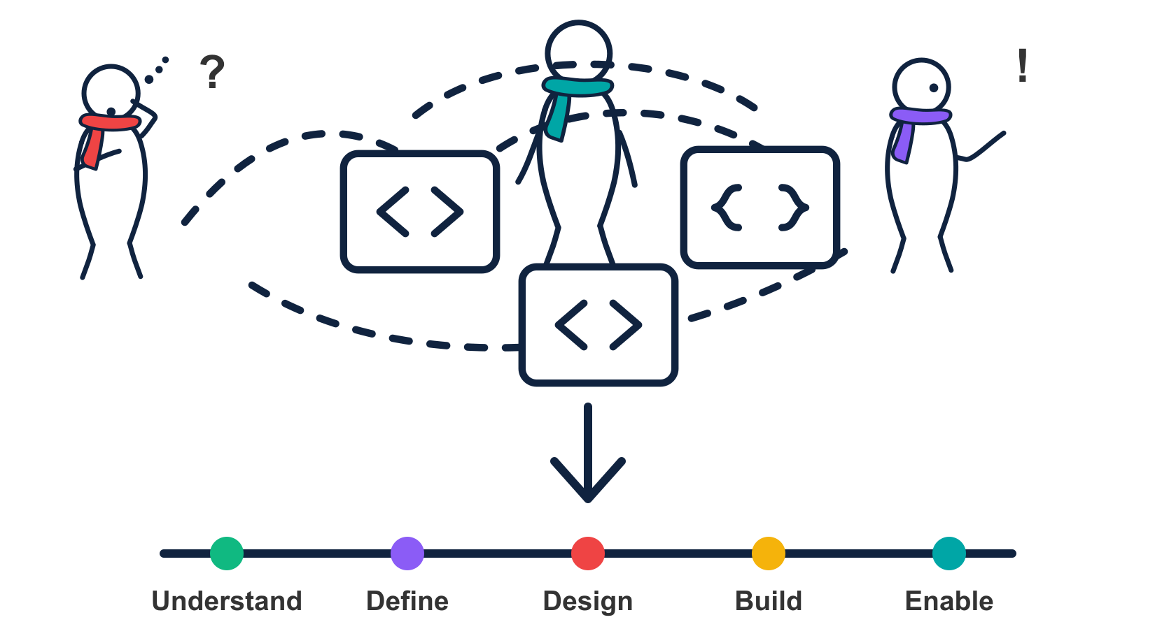
01
APIOps Cycles
Connecting API strategy,
design and delivery
A short introduction to APIOps Cycles
APIOps Cycles
APIOps Cycles
Notes:
Introduction to the APIOps Cycles method. The supplier-payment examples in this edition are fictional illustrations. Method and canvas attribution is preserved in the relevant slides.

Slide 2
02
APIOps Cycles connects decisions across the lifecycle
An open method for connecting consumer value with architecture, design, delivery and continuous improvement.
Cycle view | Primary focus
Capability Productization | Define a reusable capability and the service promise.
API Productization | Develop, publish and improve an API as a product.
Integration Productization | Connect providers and consumers through reusable integrations.
Automation | Design and govern workflows, agents and operational controls.
This introduction follows API Productization, with a financial-services case and an illustrative payment continuation.
APIOps Cycles
Notes:
APIOps introduction. Technical continuation is illustrative; no client implementation or measured improvement is claimed.
The cycle catalog provides these four views over shared stations, resource guidance and readiness criteria. This deck follows the API Productization Cycle. Case-study statements derive from the supplied anonymised Word document. The supplier-payment canvases and subsequent technical decisions are illustrative.
Sources checked 3 November 2026:
src/data/method/cycles.json
src/lib/method-engine.js

Slide 3
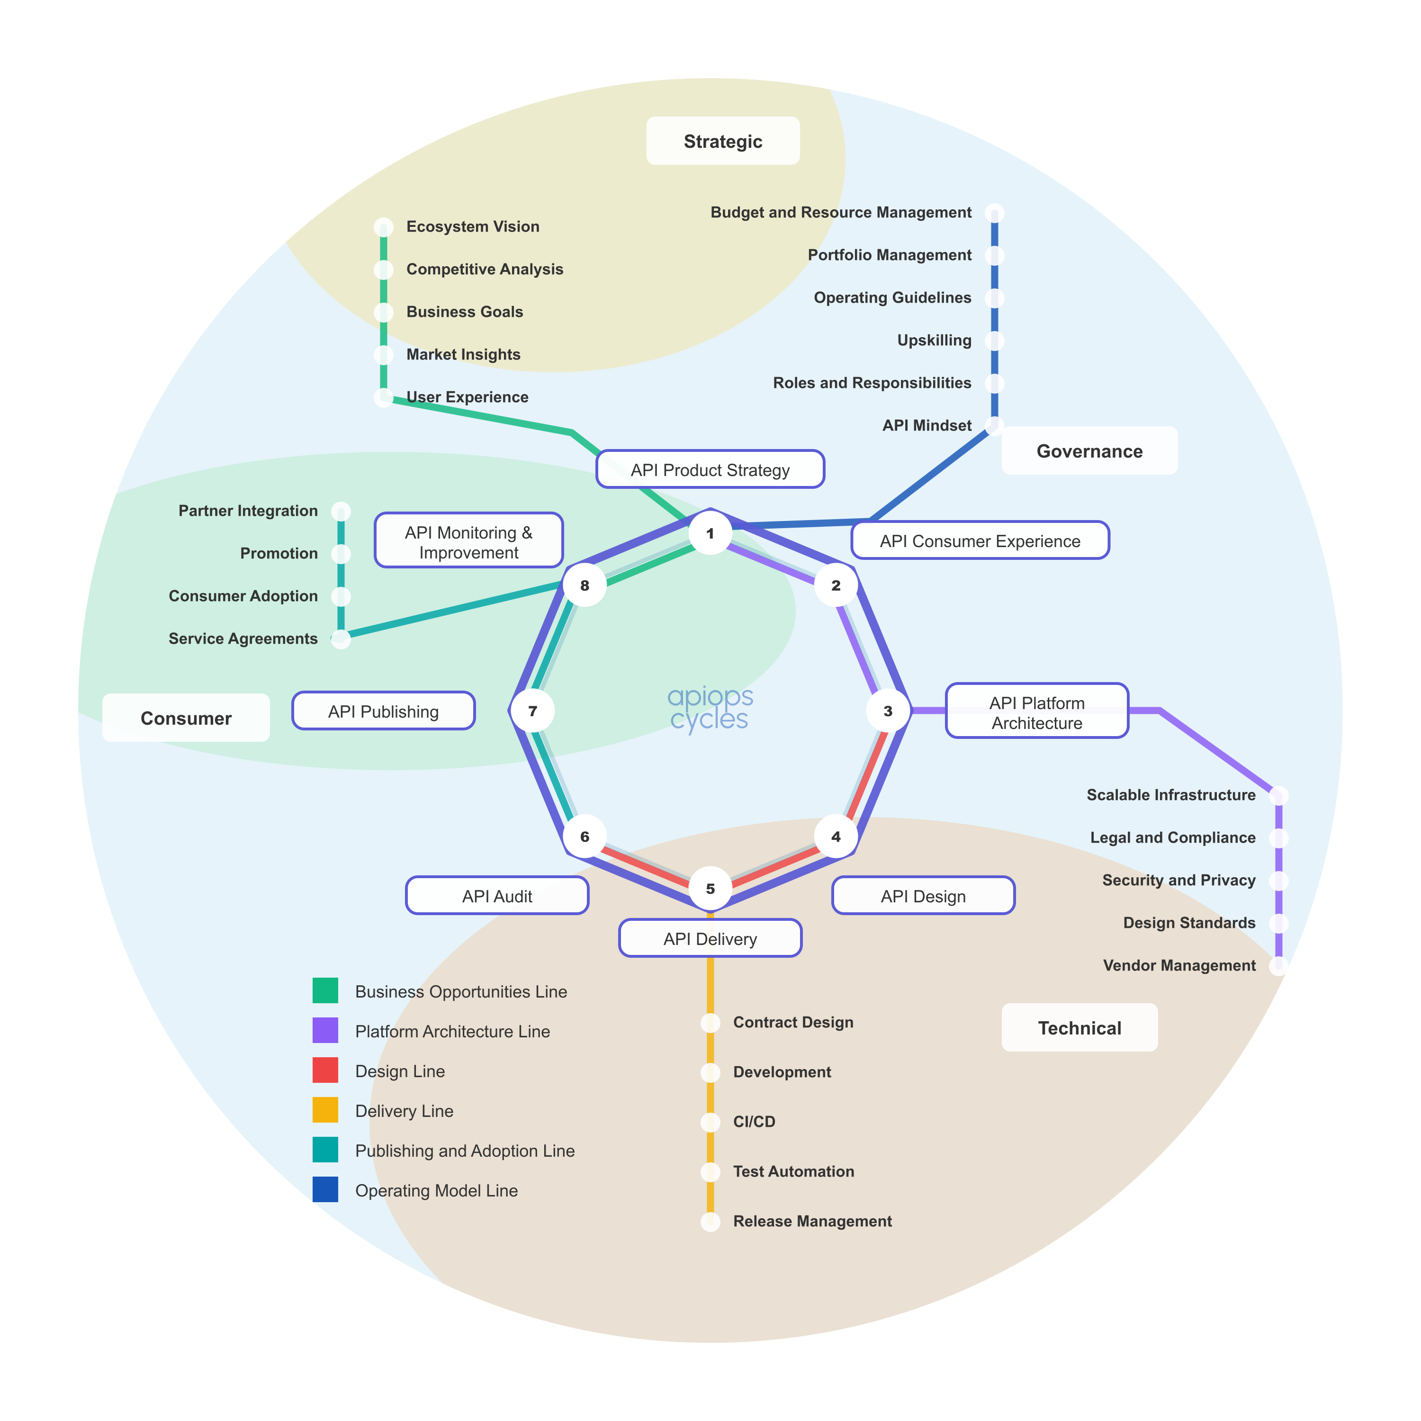
03
API Productization Cycle metro map
One lifecycle connects the work
API Product Strategy
API Consumer Experience
API Platform Architecture
API Design
API Delivery
API Audit
API Publishing
API Monitoring & Improvement
The engagement connected discovery to design, delivery and testing across these stations.
APIOps Cycles
Notes:
Source: Australian_Financial_Services_APIOps_Cycles_Case_Study (1).docx, supplied by the user. Client anonymised. Engagement by APIsFirst with partner Osaango. Benefits are qualitative; no quantified delivery or business impact is claimed.
Canonical API Productization Cycle map exported through the local repository application at /cycles/api-productization-cycle/ using Export SVG. Public reference: https://apiopscycles.com/cycles/api-productization-cycle/ . Supporting lines cover business opportunities, platform architecture, design, delivery, publishing and adoption, and operating model. The map is a method overview, not evidence that every station was completed during the engagement.

Slide 4
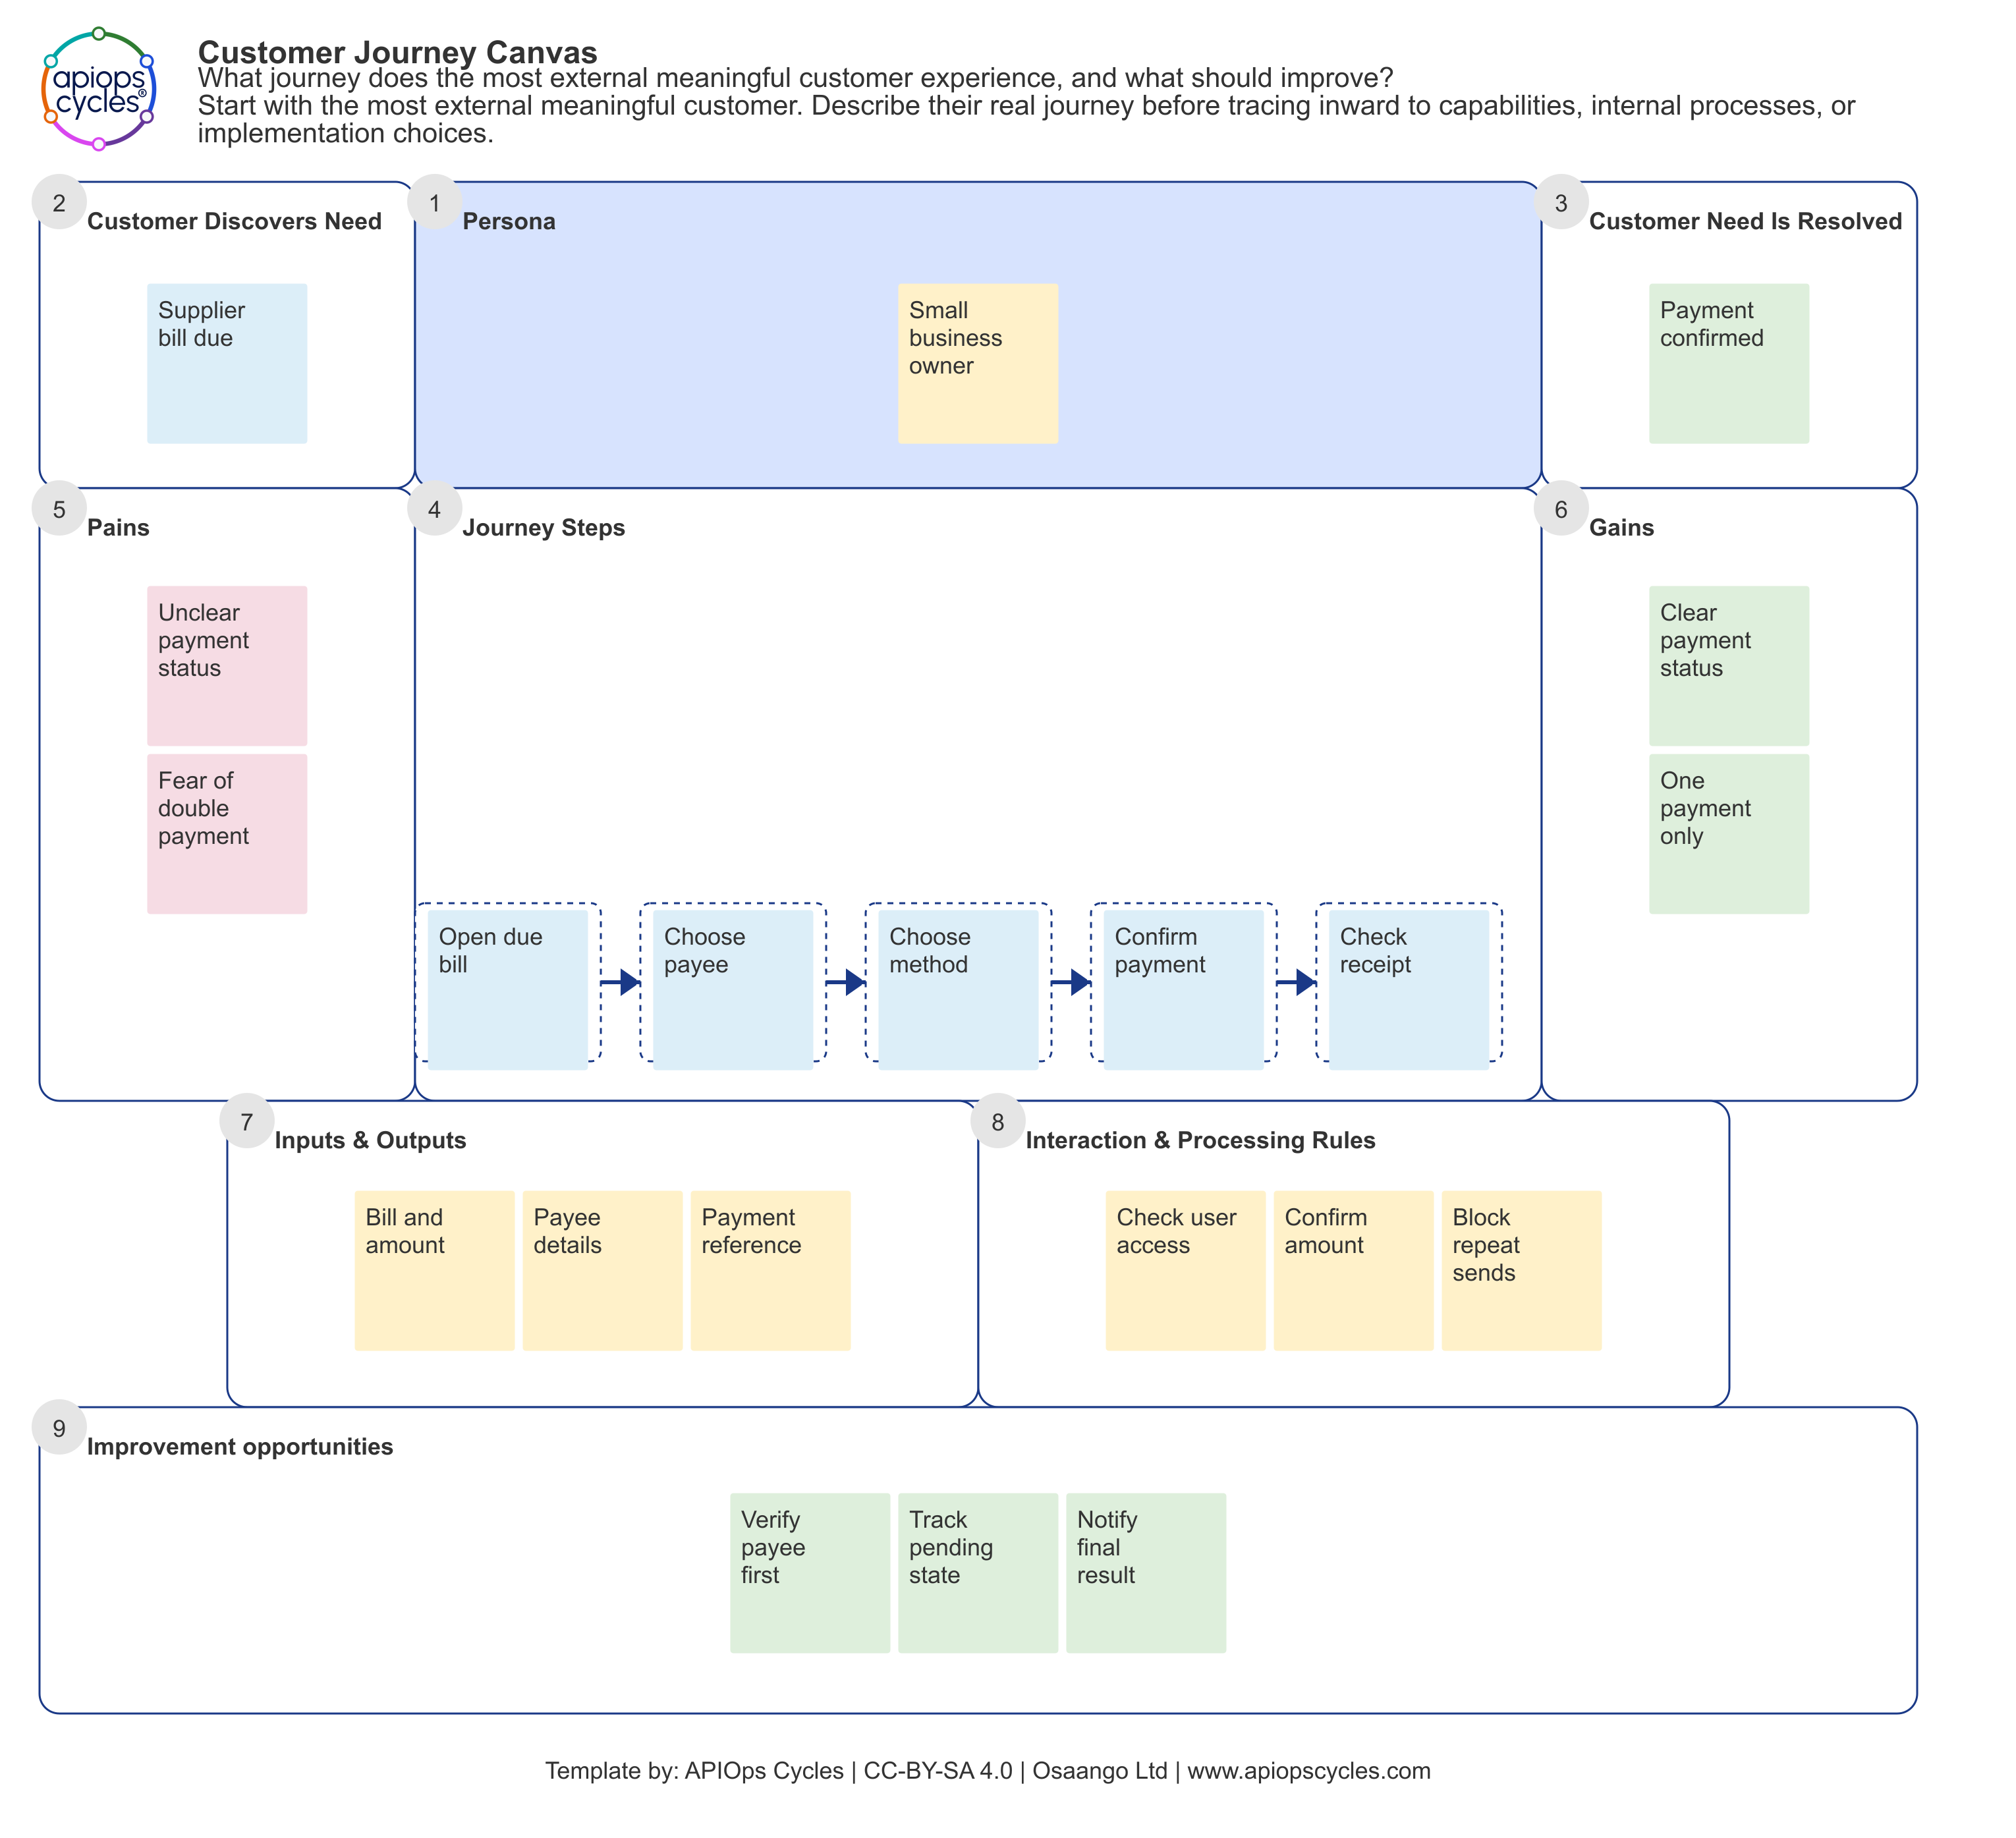
04
Customer Journey Canvas: a supplier payment
Customer and trigger
A small business owner has a supplier bill due and wants to know the payment has completed.
The customer journey
Open the due bill
Choose the payee
Choose a payment method
Confirm the payment
Check the receipt
Illustrative example. Not a client artefact.
APIOps Cycles
Notes:
Source: Australian_Financial_Services_APIOps_Cycles_Case_Study (1).docx, supplied by the user. Client anonymised. Engagement by APIsFirst with partner Osaango. Benefits are qualitative; no quantified delivery or business impact is claimed.
Newly authored fictional example for this case study: a small business owner pays a supplier invoice through a partner portal. The supplied real example set informed only the method of connecting customer tasks, pains, gains and API capabilities. No source screenshot, wording, institution, system identifier, endpoint, number or product name has been reused. Unclear status and duplicate-payment concern are illustrative hypotheses, not measured client findings. Template source: local apiops-cycles-method-data, customerJourneyCanvas. https://apiopscycles.com/resources/customer-journey-canvas/ . Template by APIOps Cycles and Osaango Ltd, CC-BY-SA 4.0. Importable example JSON: assets/illustrative_supplier_payment_customerJourneyCanvas_en.json.

Slide 5
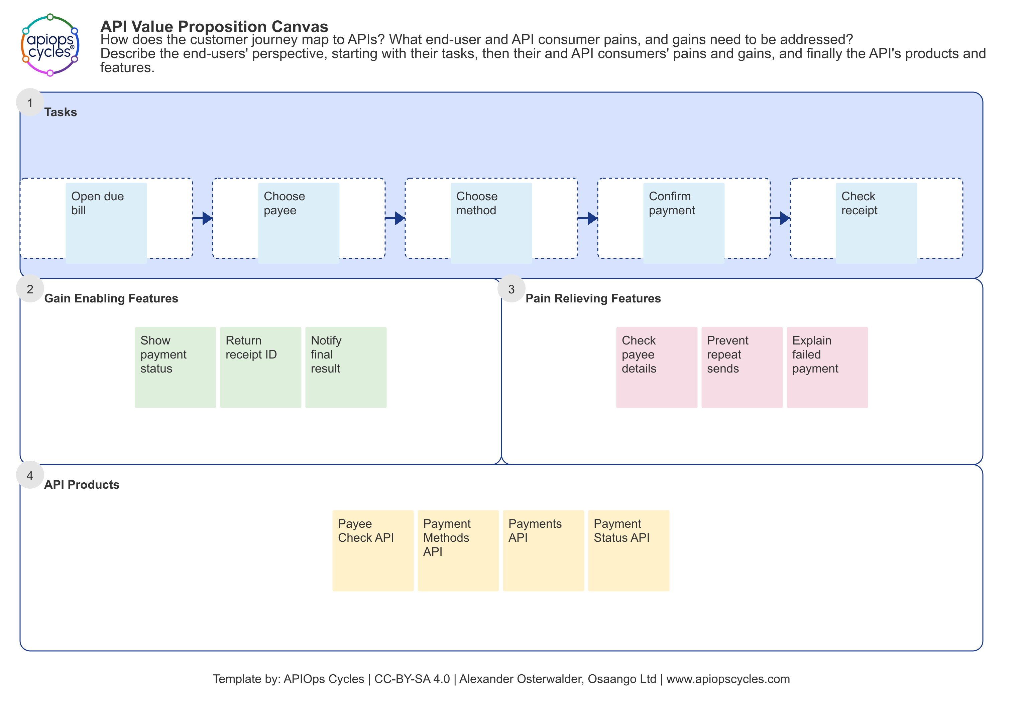
05
API Value Proposition Canvas: the same journey
Customer concern to API feature
Unclear payment status:
show progress and a receipt.
Repeat-payment concern:
prevent duplicate submissions.
Candidate API products
Payee Check API
Payment Methods API
Payments API
Payment Status API
Illustrative example. API names are provisional.
APIOps Cycles
Notes:
Source: Australian_Financial_Services_APIOps_Cycles_Case_Study (1).docx, supplied by the user. Client anonymised. Engagement by APIsFirst with partner Osaango. Benefits are qualitative; no quantified delivery or business impact is claimed.
The fictional example continues exactly the same five customer tasks as the preceding Customer Journey Canvas. Proposed gain-enabling features: status visibility, a receipt ID and notification of the final result. Proposed pain-relieving features: checking payee details, preventing repeat submissions and explaining failed payments. The four API product names are illustrative candidates, not actual client systems, delivered APIs or verified product boundaries. All canvas notes were authored afresh. No reference screenshots or client-specific details are embedded. Template source: local apiops-cycles-method-data, apiValuePropositionCanvas. https://apiopscycles.com/resources/api-value-proposition-canvas/ . Template by APIOps Cycles, Alexander Osterwalder and Osaango Ltd, CC-BY-SA 4.0. Importable example JSON: assets/illustrative_supplier_payment_apiValuePropositionCanvas_en.json.

Slide 6
06
Architecture: business needs become operating decisions
Method input | Decision it supports | Review with
Business Impact Canvas | Failure consequences, resilience and acceptable degradation | Product owner, security and operations
Locations Canvas | Trust boundaries, connectivity and data-location constraints | Architecture, security and compliance
Capacity Canvas | Demand, peaks, availability and scaling assumptions | Business and platform owners
Metrics and analytics | Observable service behaviour and consumer outcomes | Operations and API product owner
The next station needs architecture choices that stakeholders have reviewed.
APIOps Cycles
Notes:
APIOps introduction. Technical continuation is illustrative; no client implementation or measured improvement is claimed.
Canonical API Platform Architecture resources and the API Design entry criteria require validated architecture and shared conventions. Canvas contents inform decisions; they do not prescribe a vendor or deployment topology.
Sources checked 3 November 2026:
method-engine: buildStationResourceData(api-platform-architecture), buildStartData(en, api-productization-cycle)

Slide 7
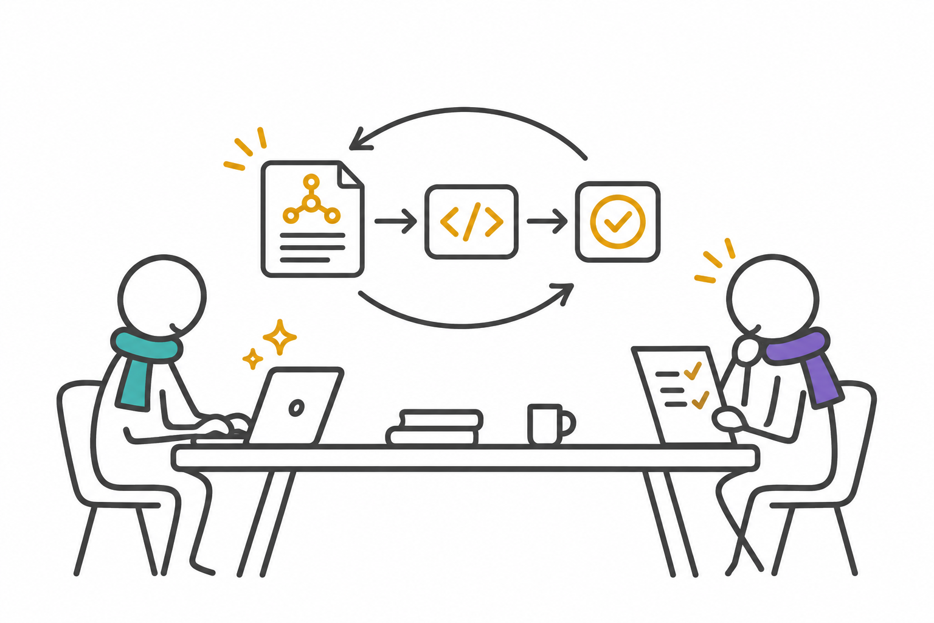
07
Building with AI works best as a bounded change
Select one reviewed operation and its acceptance criteria.
Ask for an implementation diff and tests against the contract.
Run checks, inspect behaviour and record unresolved decisions.
Have the responsible people review the evidence before merging.
Suggested task: implement payment submission with replay and cross-partner denial tests.
APIOps Cycles
Notes:
APIOps introduction. Technical continuation is illustrative; no client implementation or measured improvement is claimed.
Recommended iterative working pattern. The validated contract, domain rules, architecture decisions and critical journeys constrain the implementation. The example task is illustrative. AI output requires review and execution of meaningful tests. Source guidance explicitly connects delivery with prior method outputs. Visual generated with the built-in image generation tool using the APIOps scarf-human style; conceptual, not a client workshop photograph.
Sources checked 3 November 2026:
src/snippets/api-design-principles-guidance.md
packages/create-apiops/template/AGENTS.md

Slide 8
08
A first working cycle
Agree one API product, a consumer journey and an accountable owner.
Record the architecture choices and review one contract.
Build one path with AI assistance and meaningful tests.
Lint, audit and share findings before the next release decision.
Method and project resources
apiopscycles.com
apiops-cycles-method-data
create-apiops
CanvasCreator
Local reference versions checked: method-data 4.2.1 and create-apiops 1.1.4. 3 November 2026.
APIOps Cycles
Notes:
APIOps introduction. Technical continuation is illustrative; no client implementation or measured improvement is claimed.
Suggested introduction-to-practice sequence. Sources reviewed include the supplied anonymised Word case study, the previously prepared strategy case deck, installed apiops-cycles-method-data 4.2.1, create-apiops 1.1.4 template and initializer, and the matching local method-data repository. Technical examples and AI workflow recommendations are newly authored illustrative continuations. The case benefits remain qualitative. The local scaffold was generated with --no-install, so no live payment service, Spectral run or runtime test outcome is claimed.
Sources checked 3 November 2026:
https://apiopscycles.com/
https://github.com/APIOpsCycles/apiops-cycles-method-data
packages/create-apiops/README.md
src/lib/method-engine.js

