Slide 1

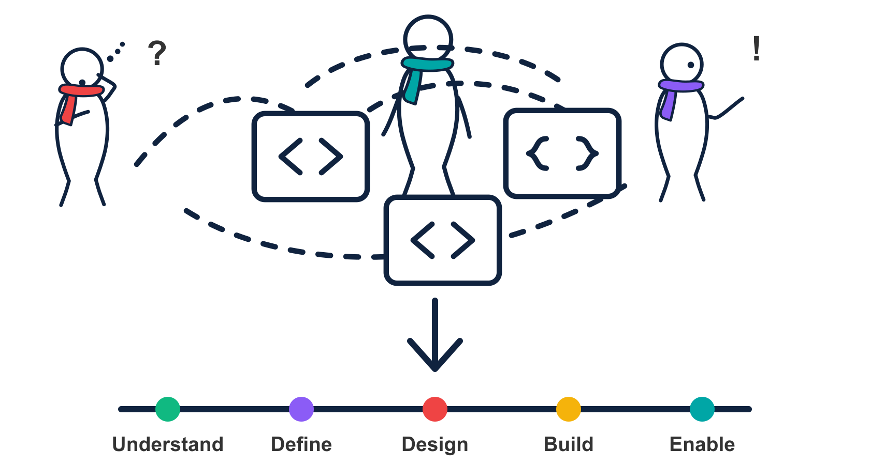
01
APIOps Cycles
API delivery and
digital product thinking
An Australian financial-services case study
APIsFirst with partner Osaango
APIOps Cycles
Notes:
Source: Australian_Financial_Services_APIOps_Cycles_Case_Study (1).docx, supplied by the user. Client anonymised. Engagement by APIsFirst with partner Osaango. Benefits are qualitative; no quantified delivery or business impact is claimed.
The engagement applied APIOps Cycles to real API product development, coordinated release planning and organisational capability improvement. It connected business discovery with architecture, security, development and testing.
Visual: APIOps Cycles design system, scene-chaos-to-capabilities.

Slide 2
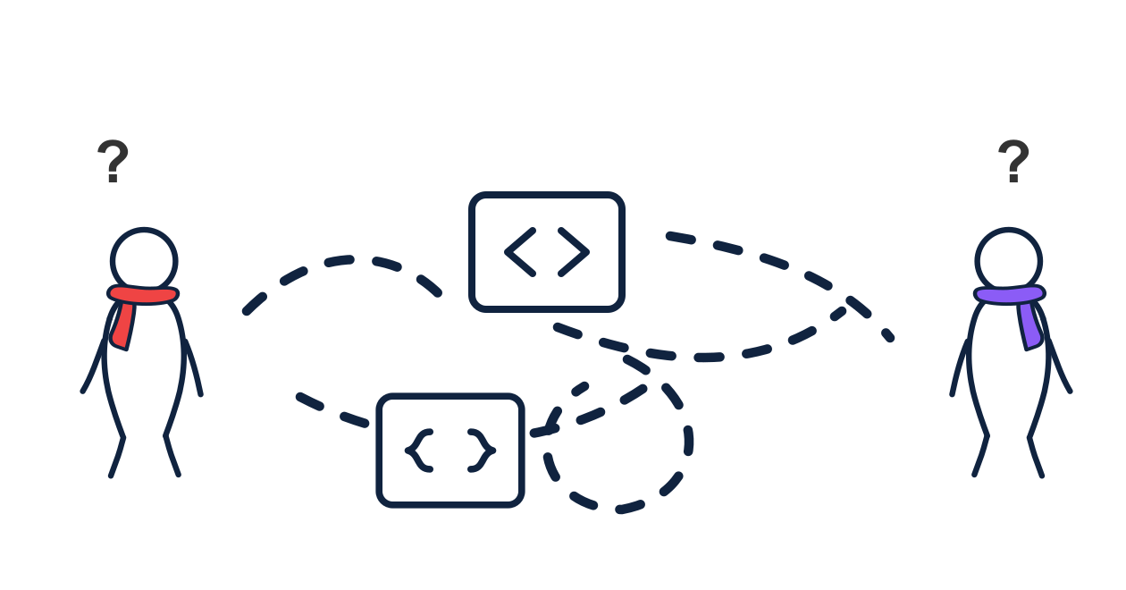
02
The challenge: dependencies across teams
Established API engineering practices
API products still depended on business and technology teams working across organisational boundaries.
Customer journeys and partner integrations had to fit internal services, legacy systems and compliance obligations.
Teams needed shared requirements, clearer ownership
and coordinated delivery decisions.
APIOps Cycles
Notes:
Source: Australian_Financial_Services_APIOps_Cycles_Case_Study (1).docx, supplied by the user. Client anonymised. Engagement by APIsFirst with partner Osaango. Benefits are qualitative; no quantified delivery or business impact is claimed.
The source describes an organisation with established API engineering practices. The challenge concerned shared business value, requirements, technical decisions, product management responsibilities and delivery coordination.
Visual: APIOps Cycles design system, scene-shared-picture-missing.

Slide 3
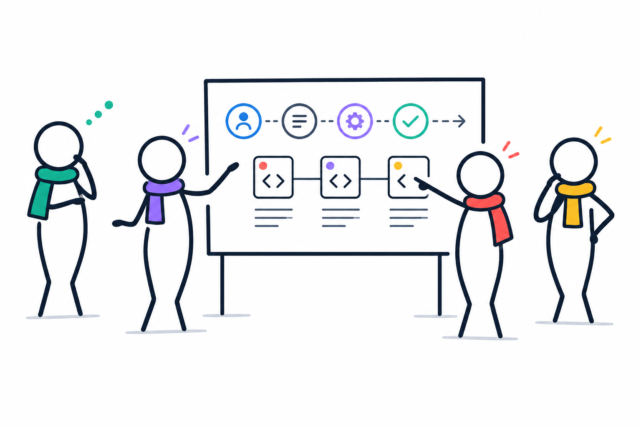
03
Collaborative discovery in the payments case
What the team did
APIsFirst and Osaango facilitated iterative workshops with business stakeholders, architects and engineers.
What the canvases made visible
Customer and API consumer journeys, value propositions, business rules and operating constraints.
Payments example: consumer details, payment method access, business risks and internal or partner channel needs.
APIOps Cycles
Notes:
Source: Australian_Financial_Services_APIOps_Cycles_Case_Study (1).docx, supplied by the user. Client anonymised. Engagement by APIsFirst with partner Osaango. Benefits are qualitative; no quantified delivery or business impact is claimed.
Source section 1: Collaborative product discovery and design. Teams also considered domain concepts, compliance, security, functional requirements and non-functional requirements. Canvases made assumptions visible before implementation choices. The source does not establish that every discrepancy was resolved.
Visual: AI-generated conceptual illustration using the APIOps scarf-human style. Not evidence of an actual workshop.

Slide 4
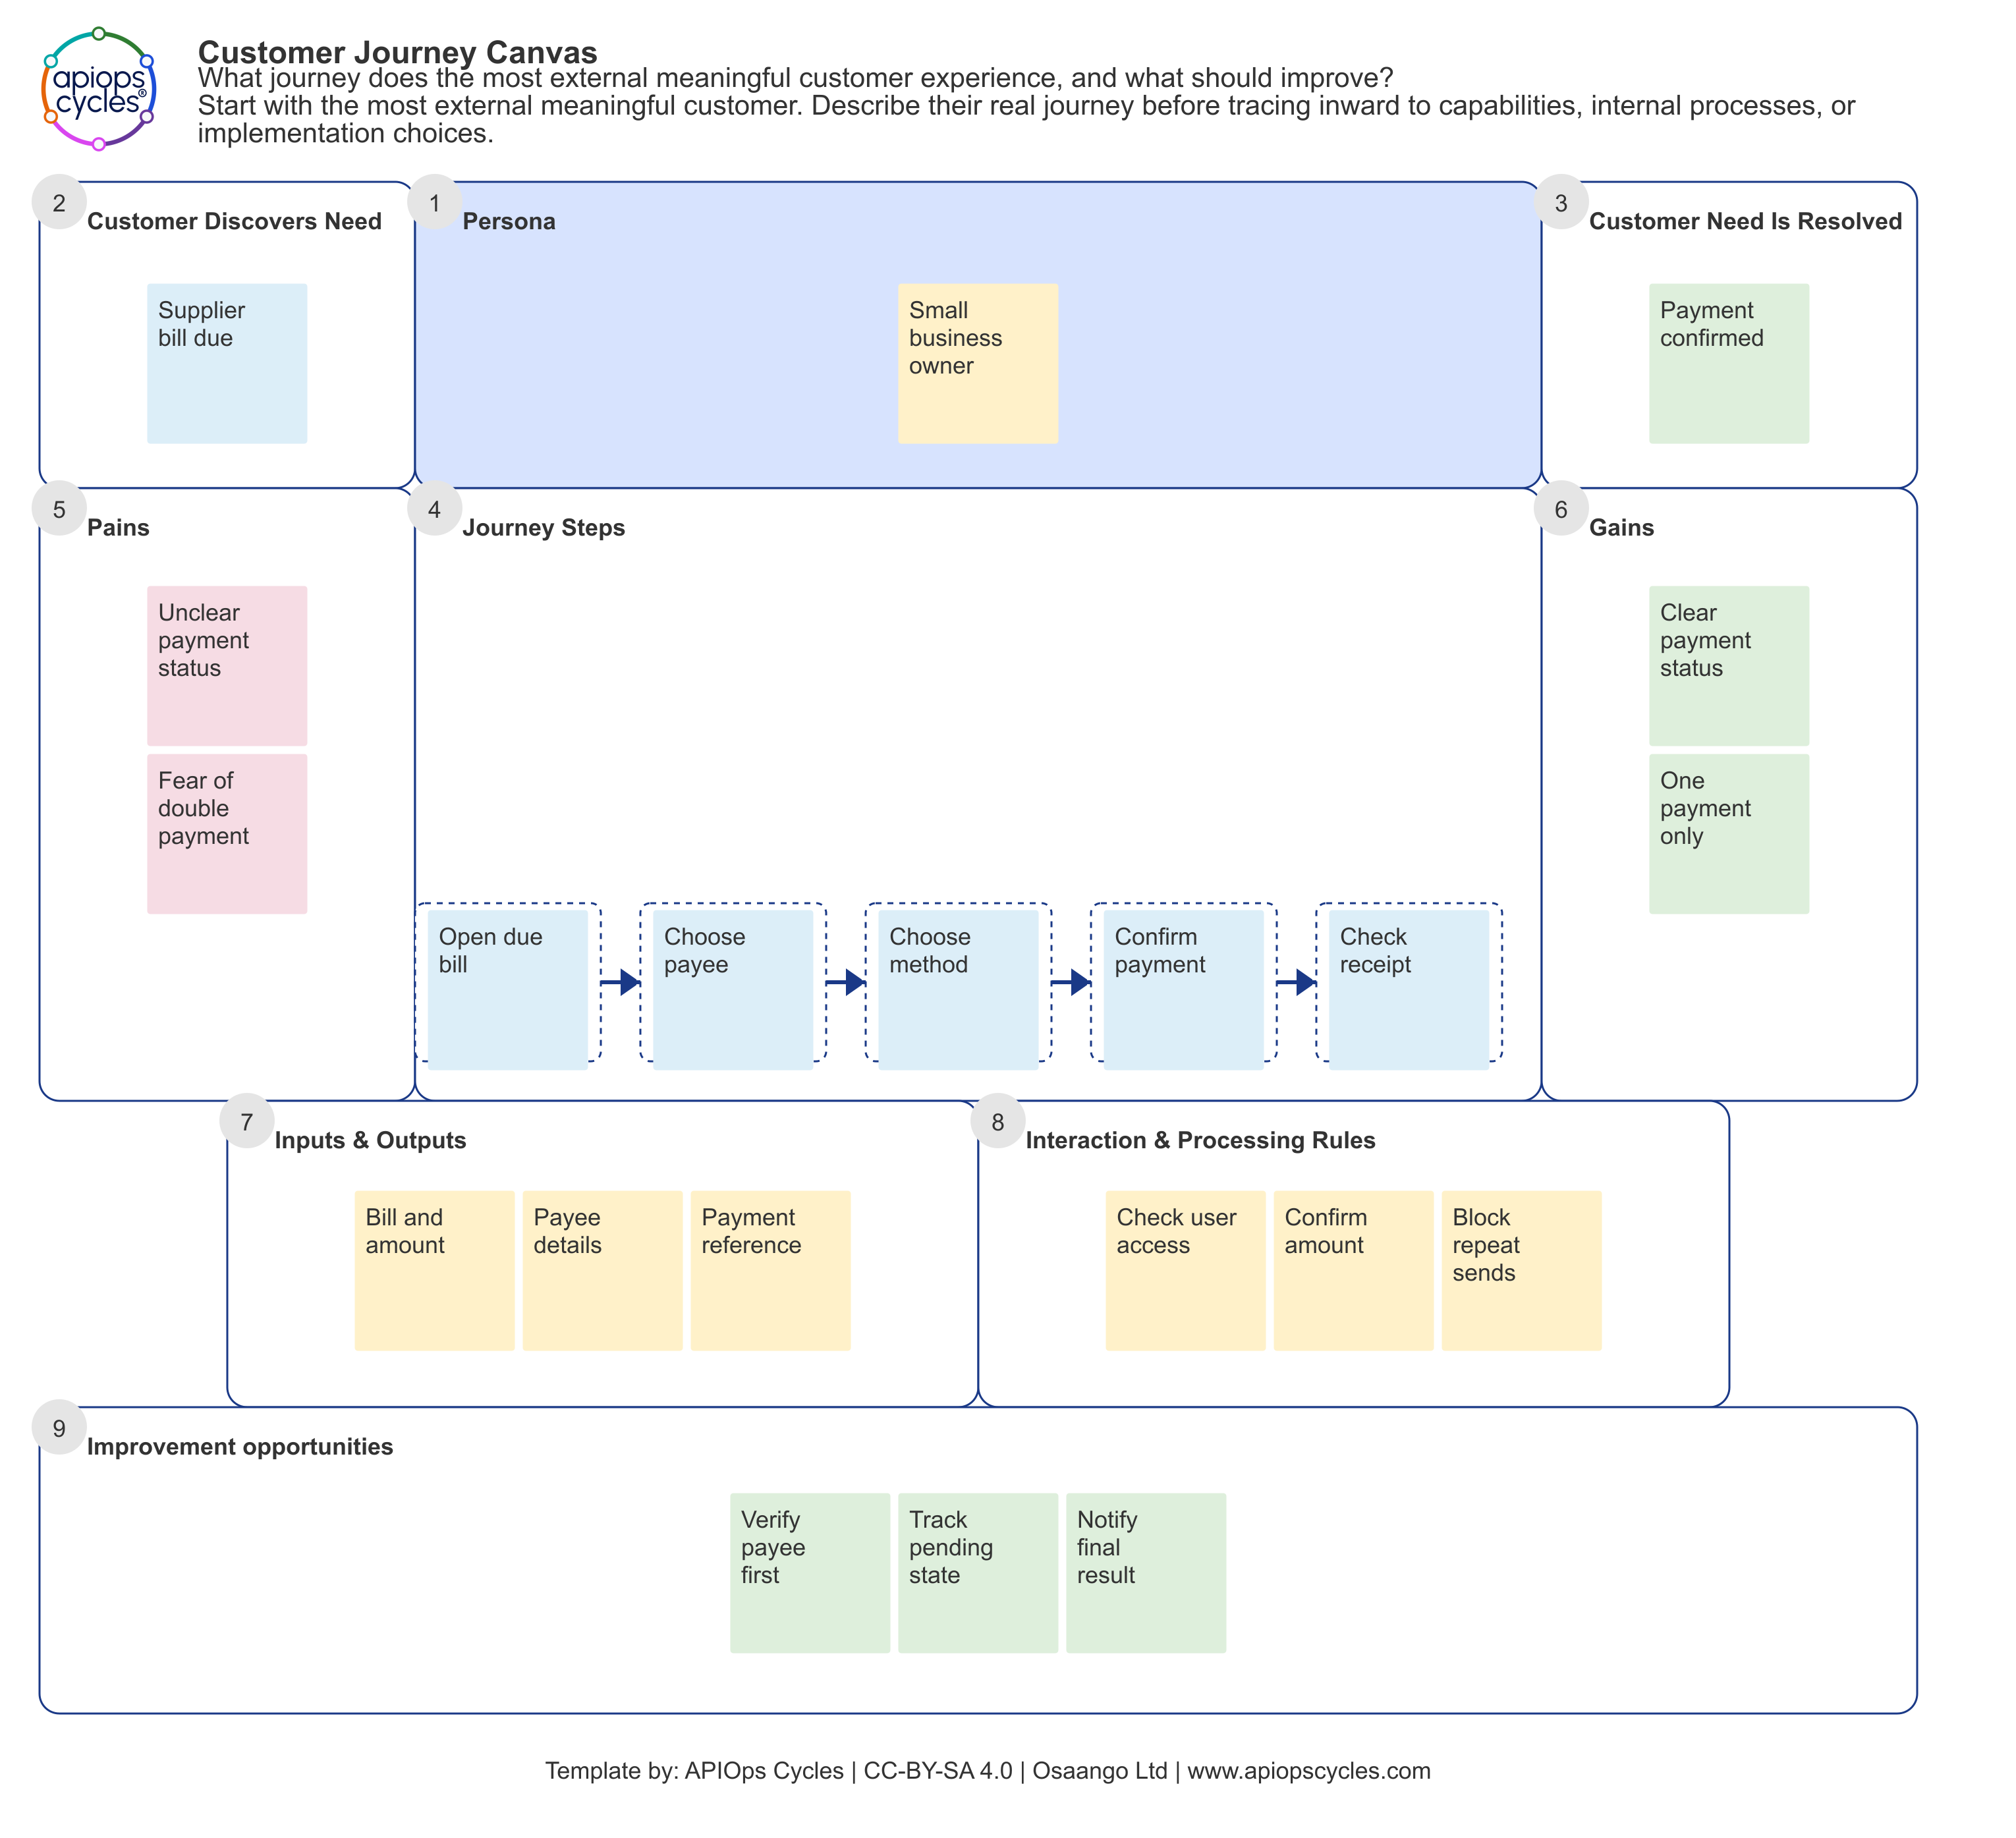
04
Customer Journey Canvas: a supplier payment
Customer and trigger
A small business owner has a supplier bill due and wants to know the payment has completed.
The customer journey
Open the due bill
Choose the payee
Choose a payment method
Confirm the payment
Check the receipt
Illustrative example. Not a client artefact.
APIOps Cycles
Notes:
Source: Australian_Financial_Services_APIOps_Cycles_Case_Study (1).docx, supplied by the user. Client anonymised. Engagement by APIsFirst with partner Osaango. Benefits are qualitative; no quantified delivery or business impact is claimed.
Newly authored fictional example for this case study: a small business owner pays a supplier invoice through a partner portal. The supplied real example set informed only the method of connecting customer tasks, pains, gains and API capabilities. No source screenshot, wording, institution, system identifier, endpoint, number or product name has been reused. Unclear status and duplicate-payment concern are illustrative hypotheses, not measured client findings. Template source: local apiops-cycles-method-data, customerJourneyCanvas. https://apiopscycles.com/resources/customer-journey-canvas/ . Template by APIOps Cycles and Osaango Ltd, CC-BY-SA 4.0. Importable example JSON: assets/illustrative_supplier_payment_customerJourneyCanvas_en.json.

Slide 5
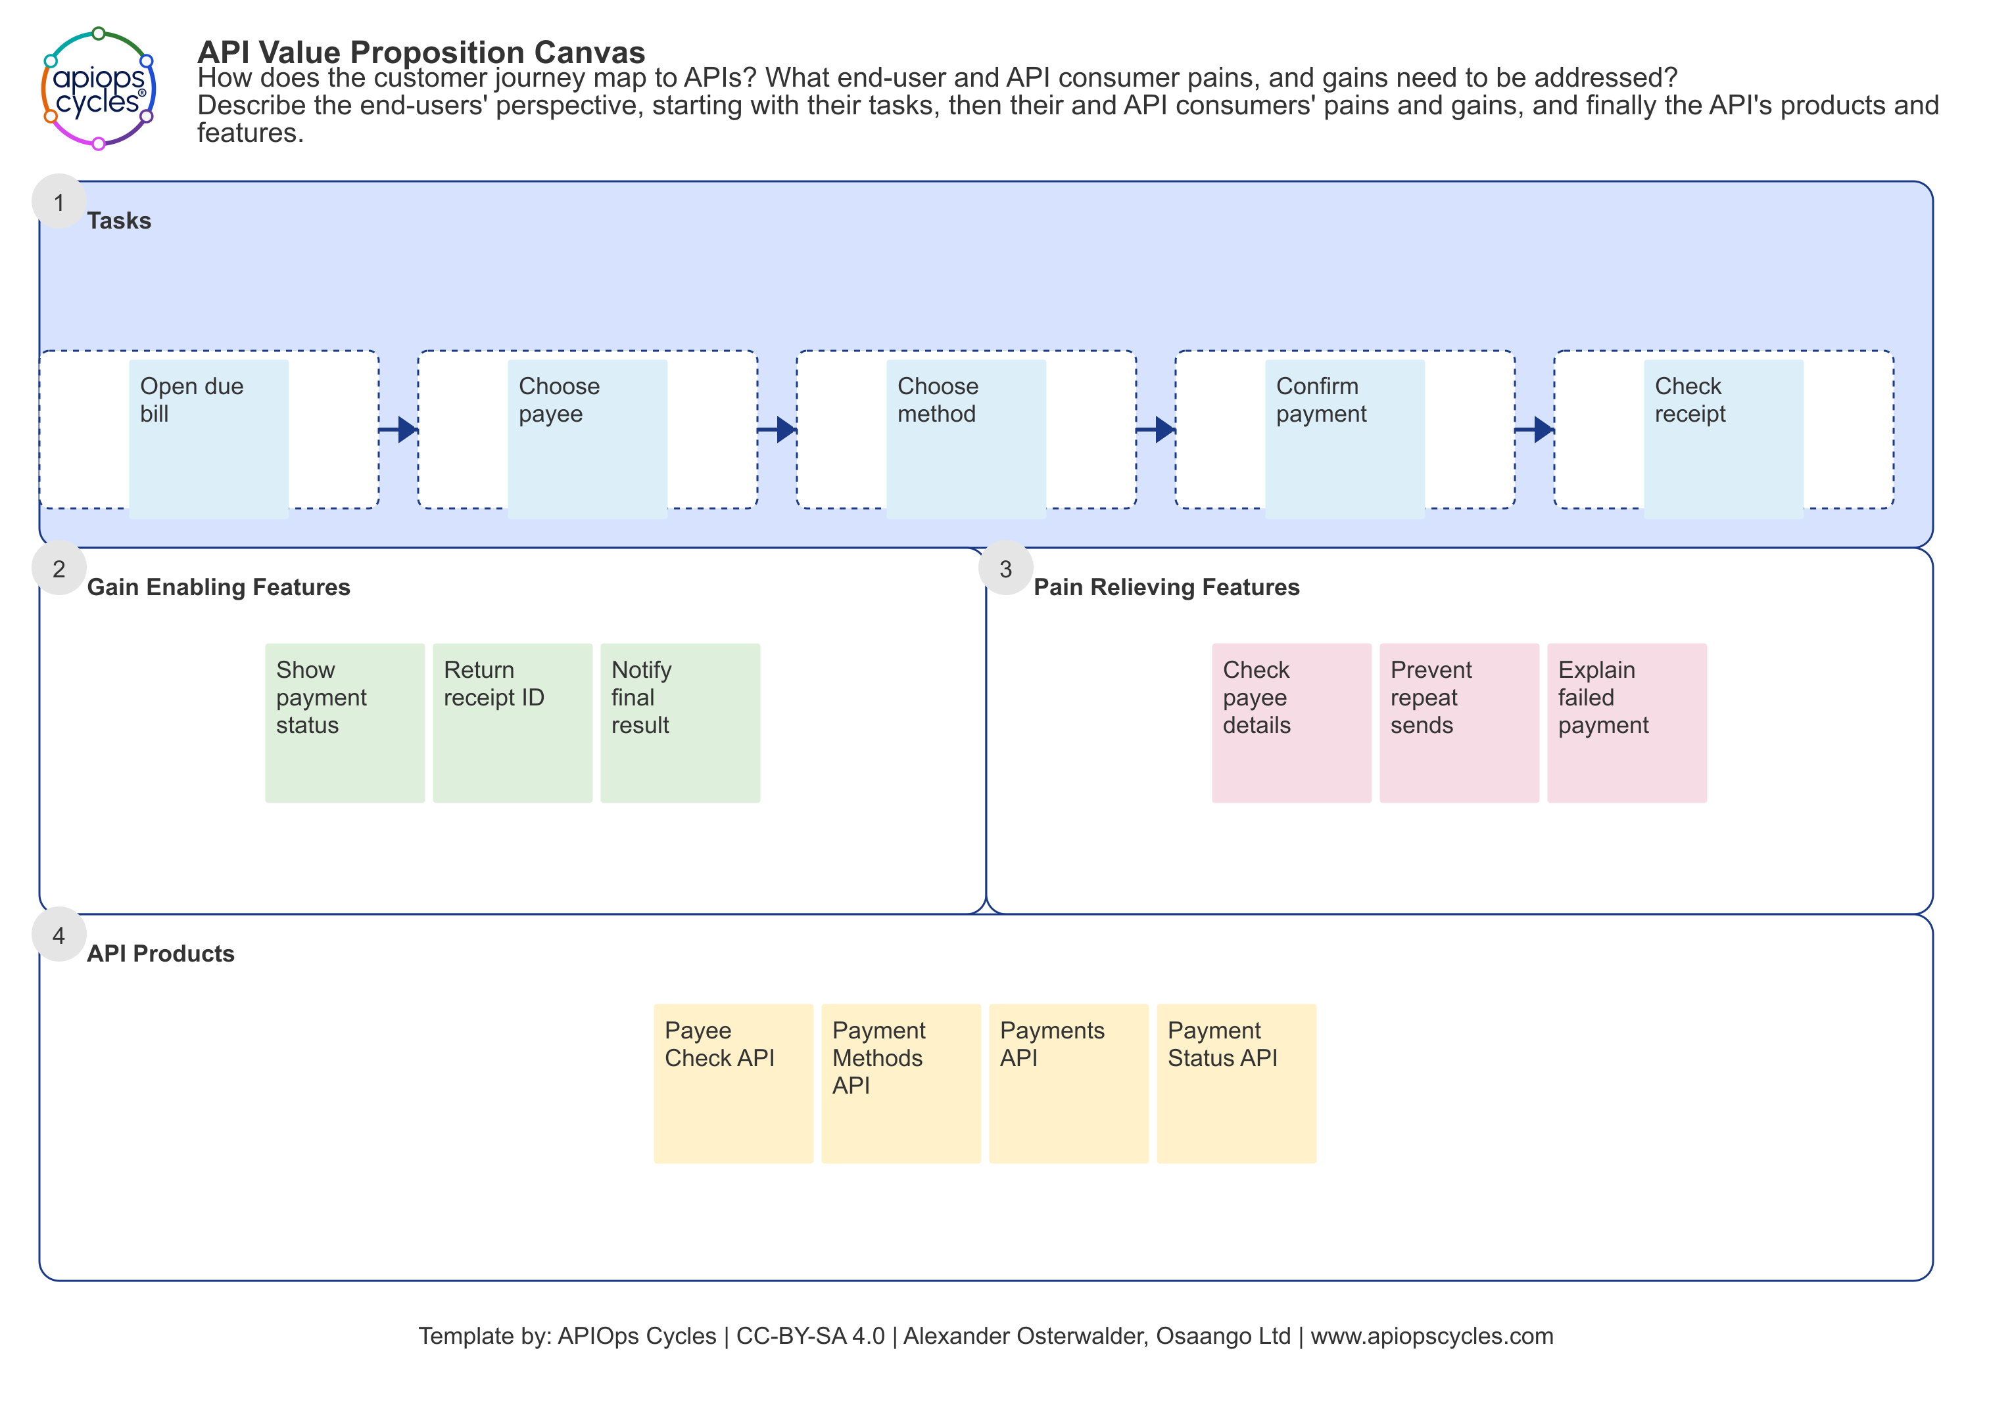
05
API Value Proposition Canvas: the same journey
Customer concern to API feature
Unclear payment status:
show progress and a receipt.
Repeat-payment concern:
prevent duplicate submissions.
Candidate API products
Payee Check API
Payment Methods API
Payments API
Payment Status API
Illustrative example. API names are provisional.
APIOps Cycles
Notes:
Source: Australian_Financial_Services_APIOps_Cycles_Case_Study (1).docx, supplied by the user. Client anonymised. Engagement by APIsFirst with partner Osaango. Benefits are qualitative; no quantified delivery or business impact is claimed.
The fictional example continues exactly the same five customer tasks as the preceding Customer Journey Canvas. Proposed gain-enabling features: status visibility, a receipt ID and notification of the final result. Proposed pain-relieving features: checking payee details, preventing repeat submissions and explaining failed payments. The four API product names are illustrative candidates, not actual client systems, delivered APIs or verified product boundaries. All canvas notes were authored afresh. No reference screenshots or client-specific details are embedded. Template source: local apiops-cycles-method-data, apiValuePropositionCanvas. https://apiopscycles.com/resources/api-value-proposition-canvas/ . Template by APIOps Cycles, Alexander Osterwalder and Osaango Ltd, CC-BY-SA 4.0. Importable example JSON: assets/illustrative_supplier_payment_apiValuePropositionCanvas_en.json.

Slide 6
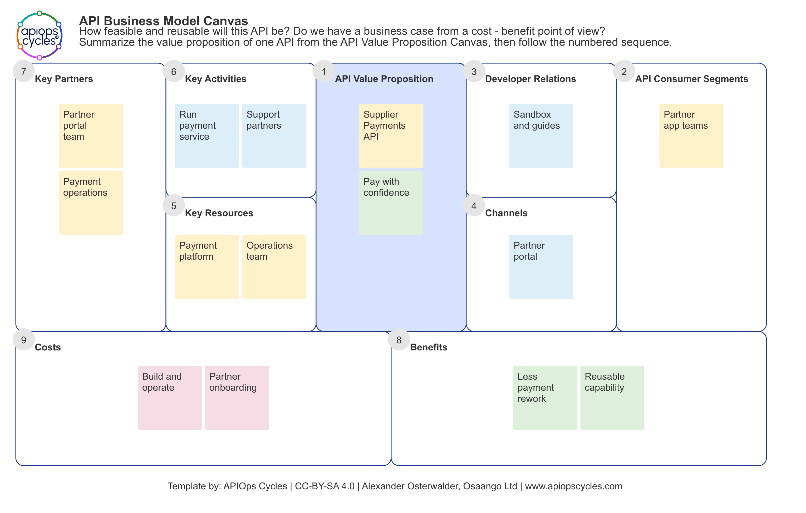
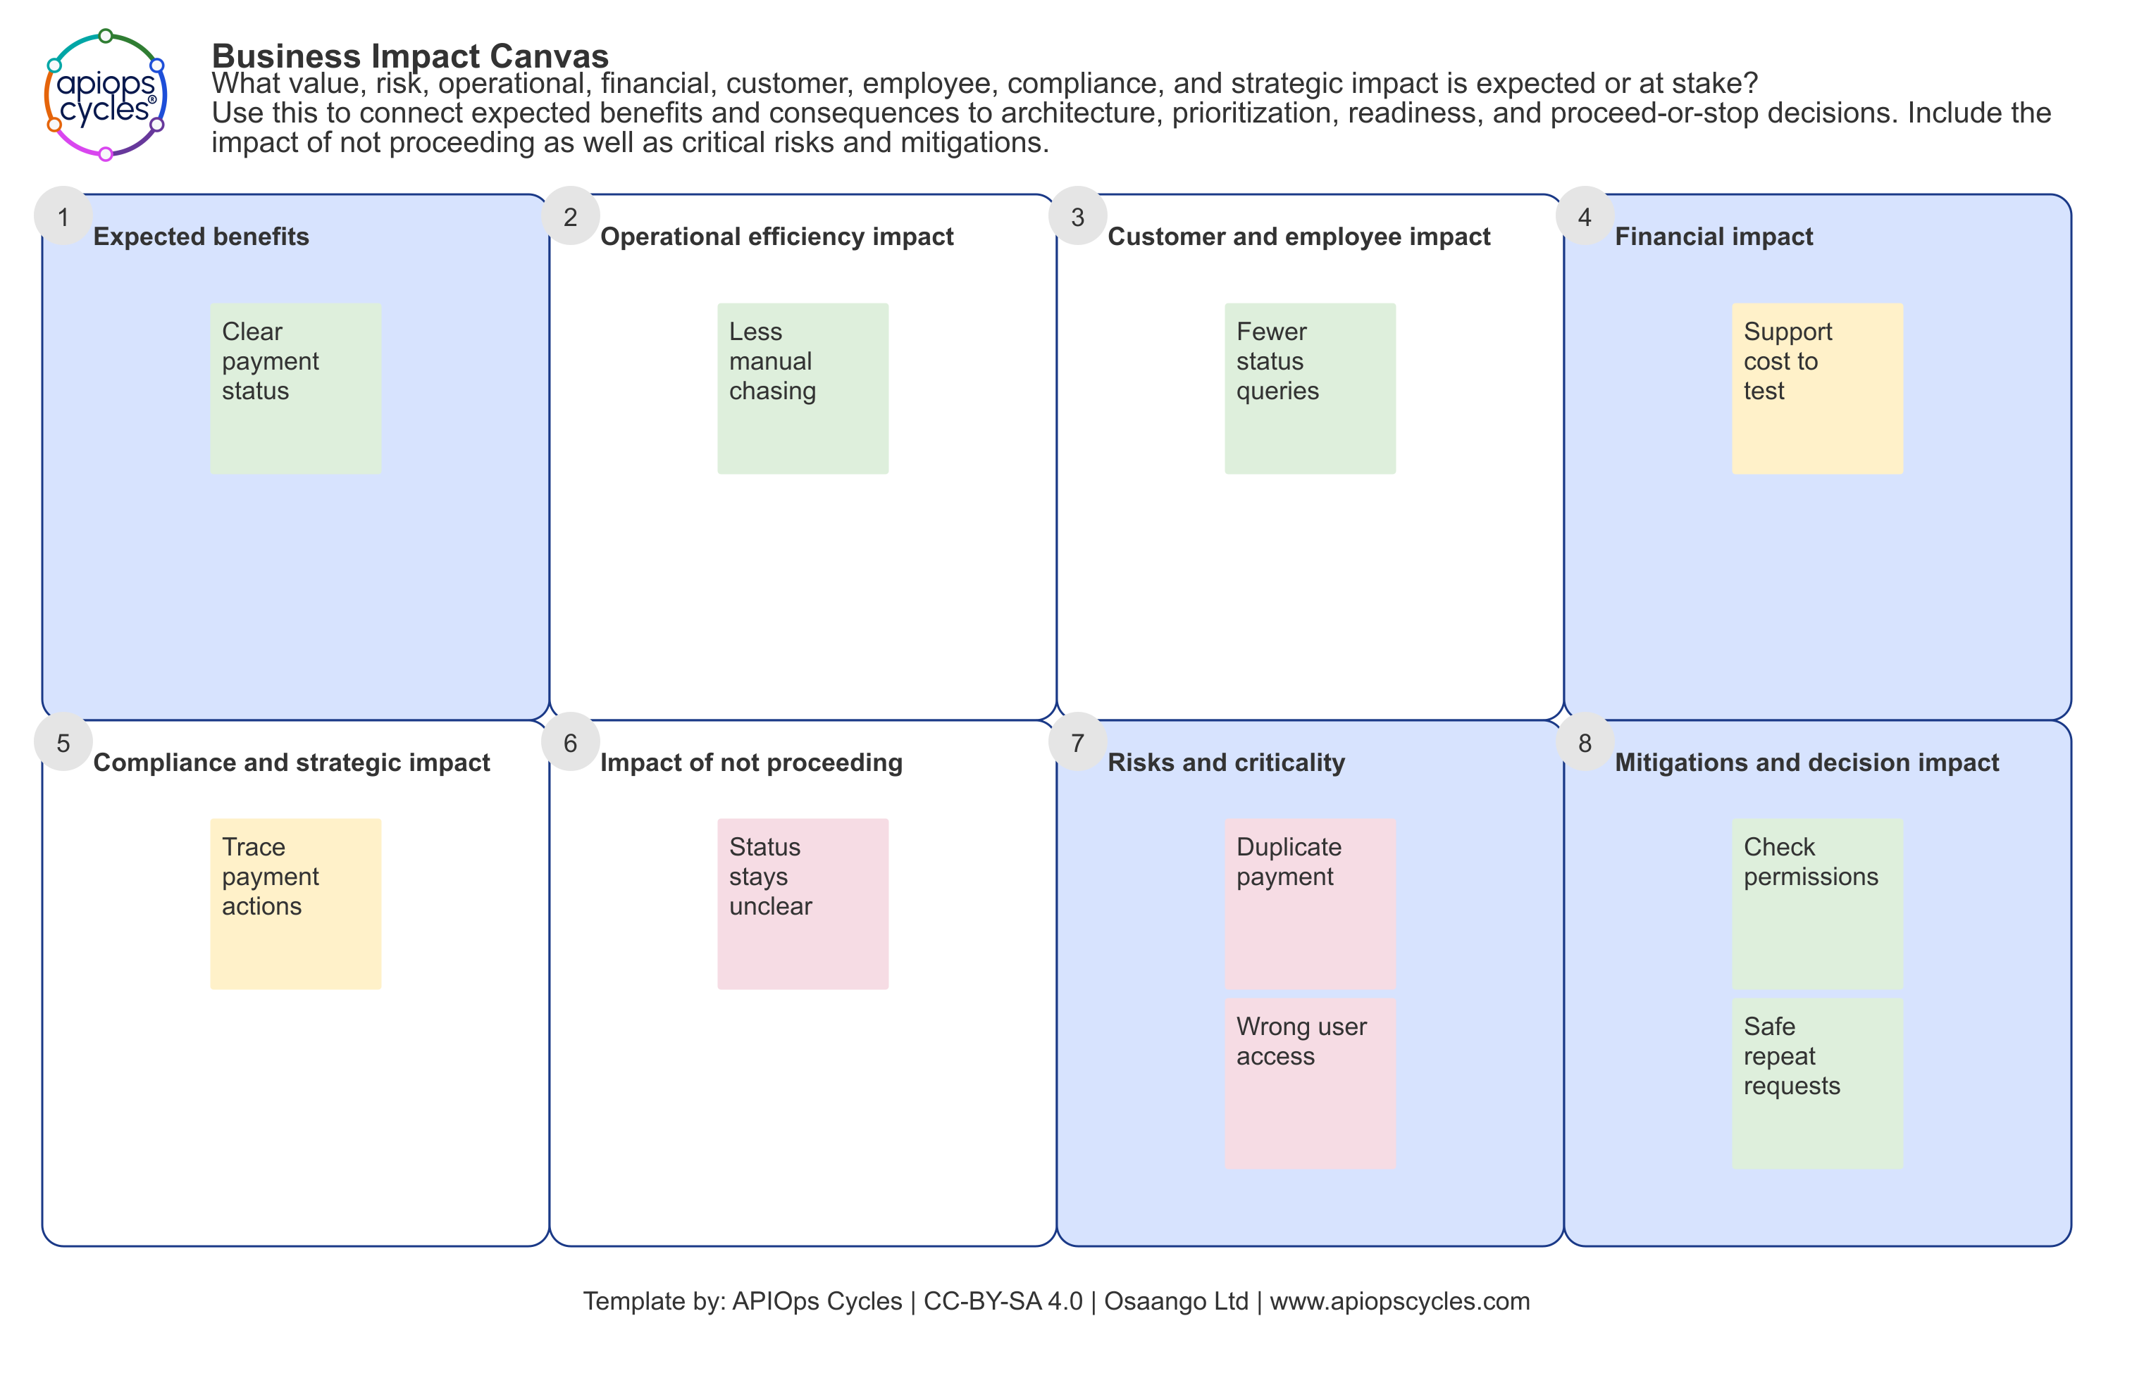
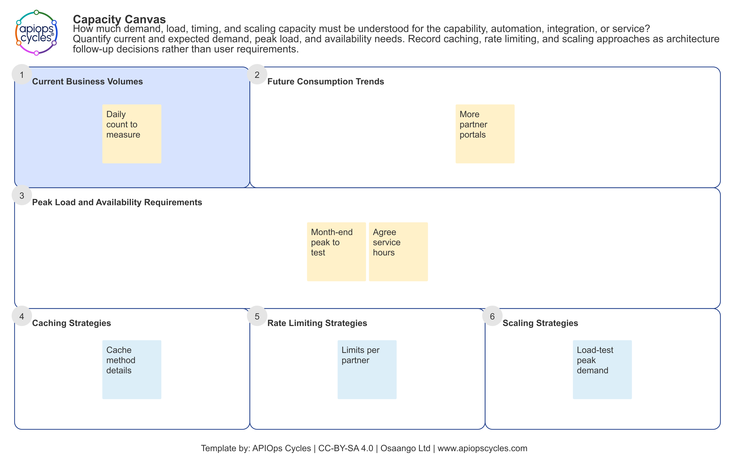
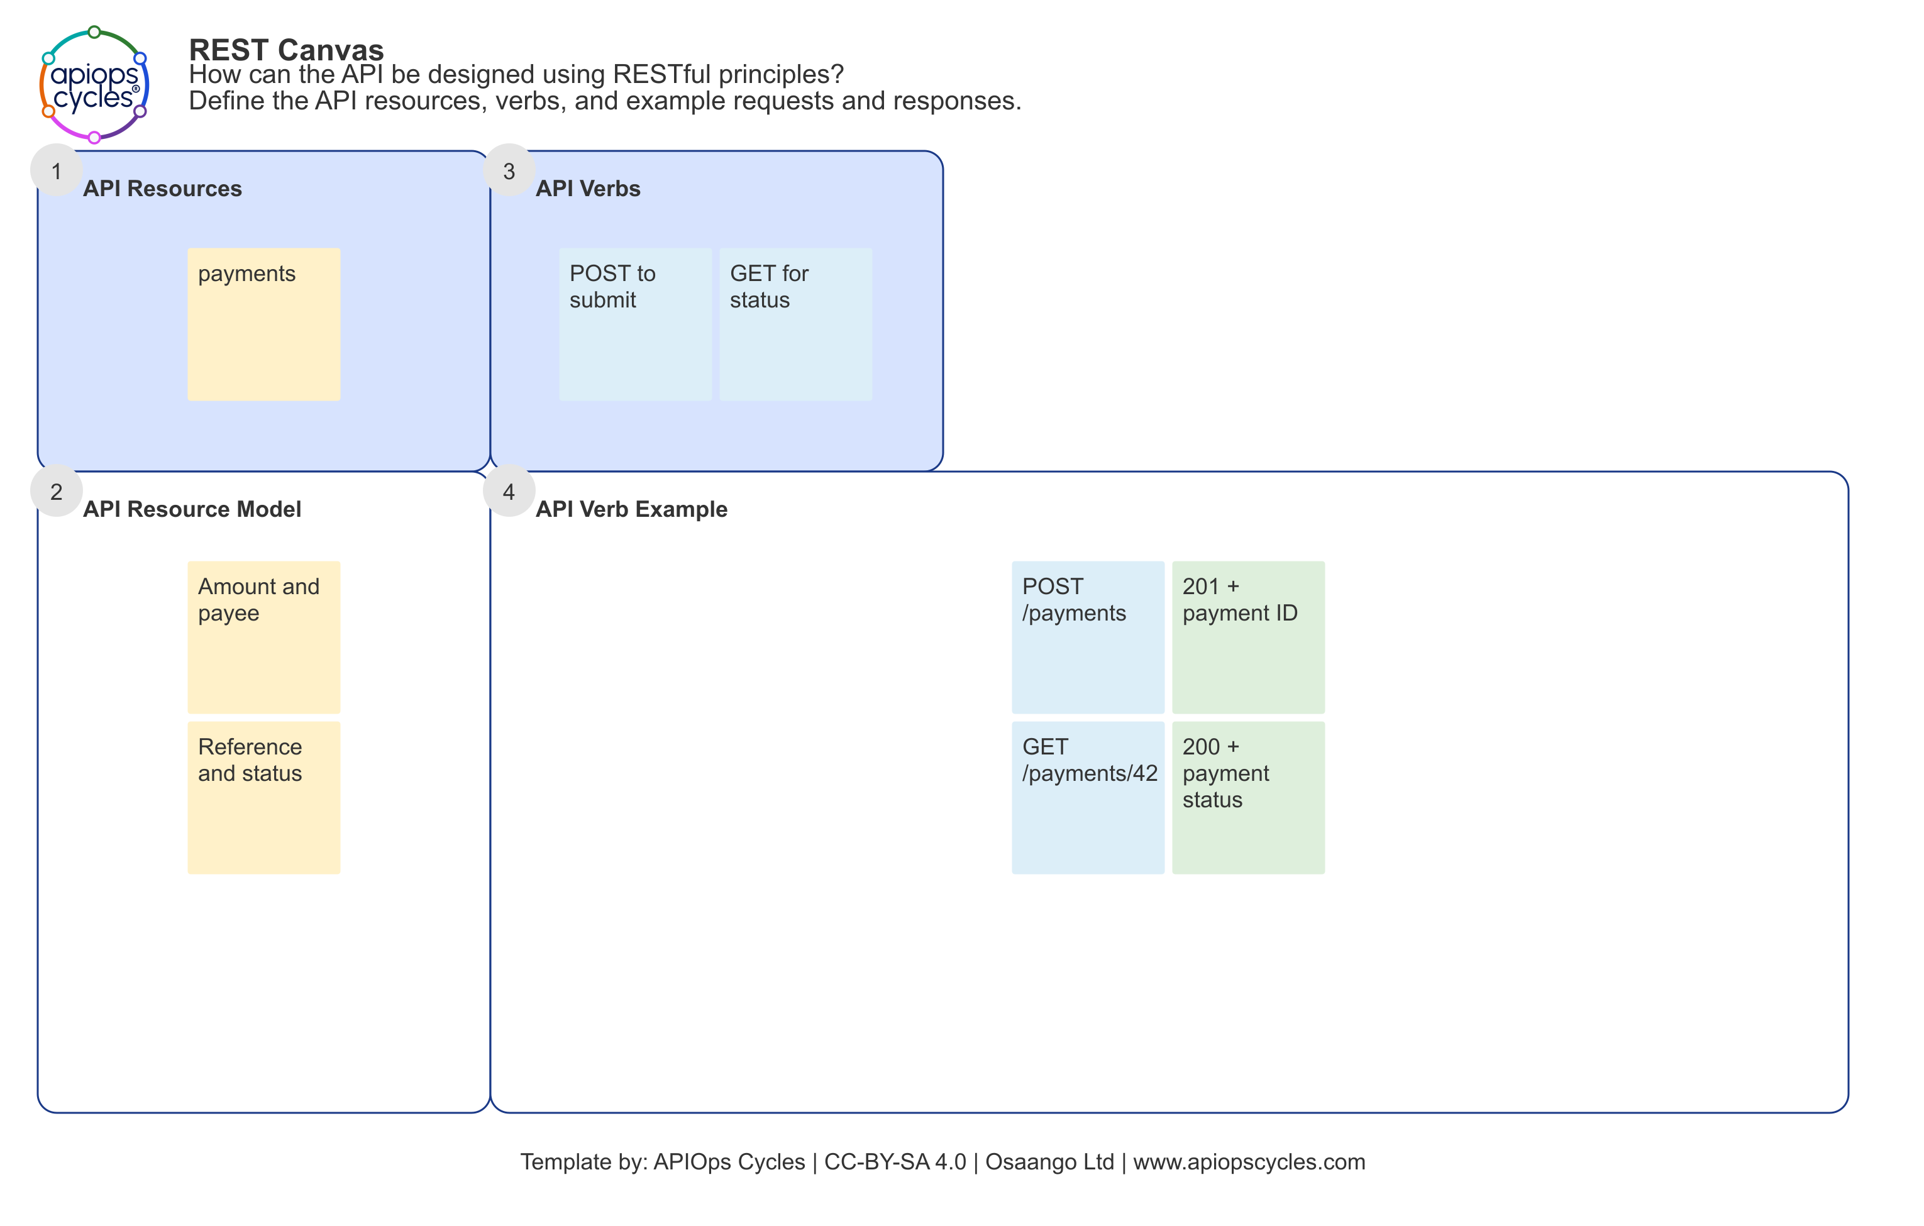
06
Other canvases supporting API product decisions
API Business Model Canvas
Business Impact Canvas
Value, partners and costs of the payments service
Expected benefits, consequences and critical risks
Capacity Canvas
REST API Canvas
Demand baseline, peak load and scaling decisions
Payment resources, verbs and response examples
Illustrative supplier-payment examples. Capacity measurements and assumptions require validation.
APIOps Cycles
Notes:
Source: Australian_Financial_Services_APIOps_Cycles_Case_Study (1).docx, supplied by the user. Client anonymised. Engagement by APIsFirst with partner Osaango. Benefits are qualitative; no quantified delivery or business impact is claimed.
Four newly authored illustrative examples continue the fictional supplier-payment scenario. They demonstrate the canonical API Business Model, Business Impact, Capacity and REST canvases. They do not reproduce the supplied real reference set, and are not evidence of actual client artefacts or delivered capabilities. The business-model canvas names the provisional Supplier Payments API before its value proposition. Impact entries describe expected benefits and risks, not observed impact. Capacity entries explicitly identify a volume baseline to measure, a peak to test and service hours to agree; no traffic forecast or measured capacity is invented. REST request and response examples are illustrative only. Canonical templates: local apiops-cycles-method-data canvasData.json and localizedData.json, IDs apiBusinessModelCanvas, businessImpactCanvas, capacityCanvas, restCanvas. Template attribution: APIOps Cycles and Osaango Ltd, with Alexander Osterwalder for API Business Model Canvas. CC-BY-SA 4.0. Importable illustrative JSON and full-size canvas images are saved under assets.

Slide 7
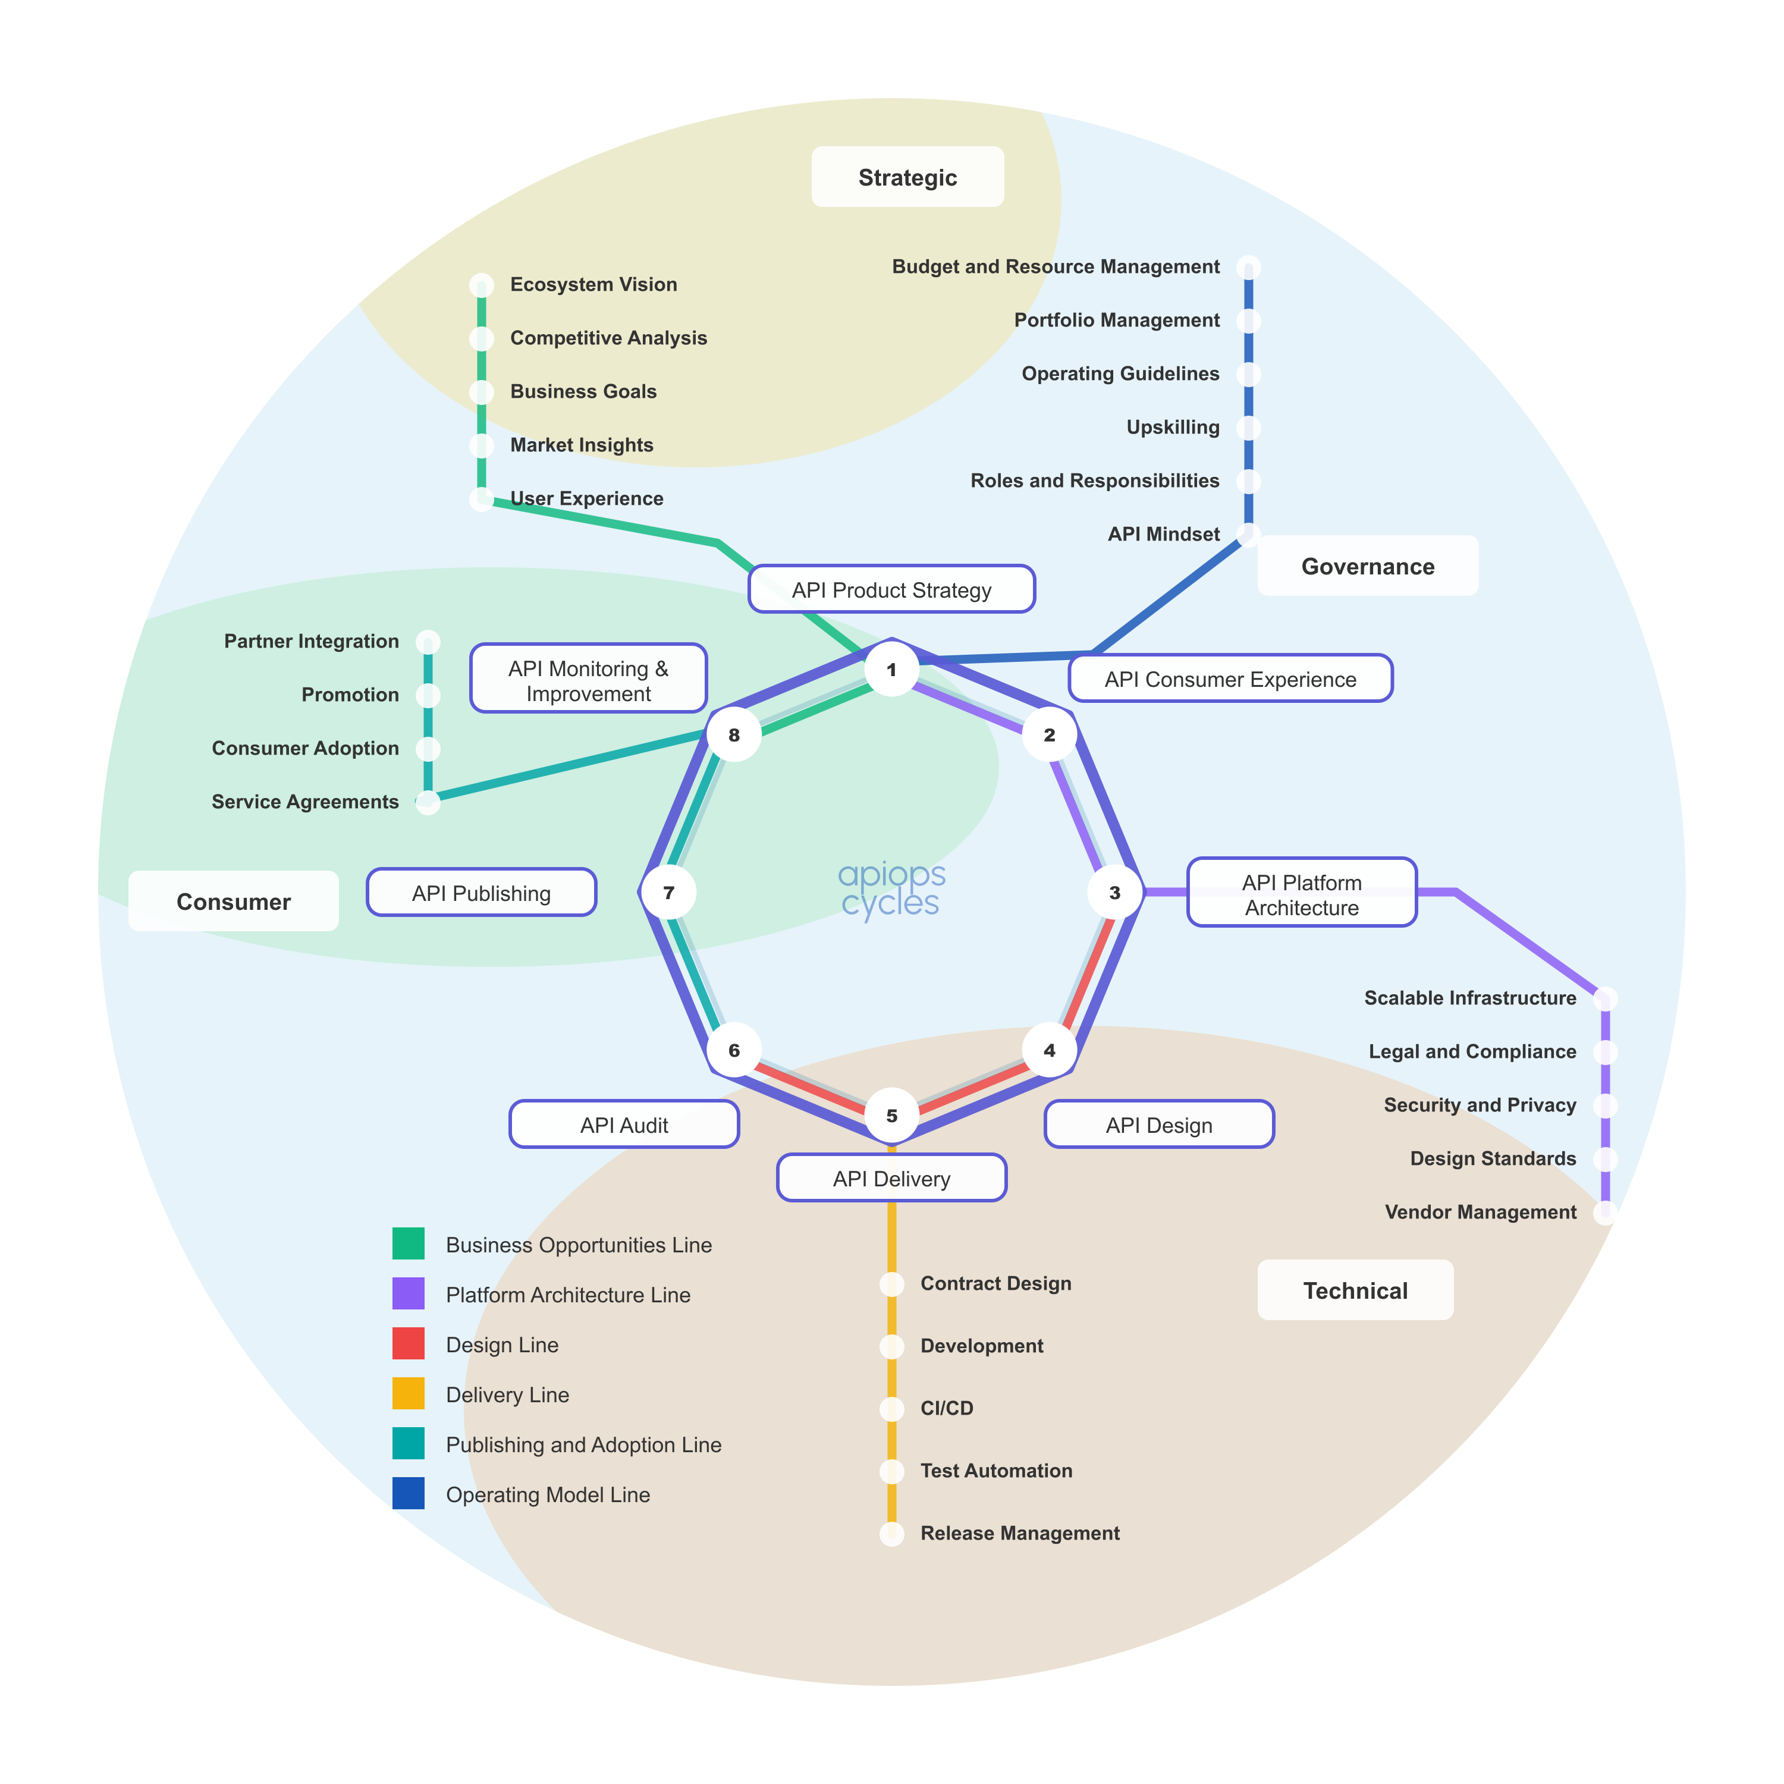
07
API Productization Cycle metro map
One lifecycle connects the work
API Product Strategy
API Consumer Experience
API Platform Architecture
API Design
API Delivery
API Audit
API Publishing
API Monitoring & Improvement
The engagement connected discovery to design, delivery and testing across these stations.
APIOps Cycles
Notes:
Source: Australian_Financial_Services_APIOps_Cycles_Case_Study (1).docx, supplied by the user. Client anonymised. Engagement by APIsFirst with partner Osaango. Benefits are qualitative; no quantified delivery or business impact is claimed.
Canonical API Productization Cycle map exported through the local repository application at /cycles/api-productization-cycle/ using Export SVG. Public reference: https://apiopscycles.com/cycles/api-productization-cycle/ . Supporting lines cover business opportunities, platform architecture, design, delivery, publishing and adoption, and operating model. The map is a method overview, not evidence that every station was completed during the engagement.

Slide 8
08
Discovery informed decisions across the lifecycle
Payment API design connected consumer needs to technical controls
Consumer tasks | Requirements | API design | Controls | Testing
Journeys and channel needs | Business rules and constraints | Domain model and contracts | Access, limits and monitoring | API test automation
Practical support
AI modernisation guidance
Guidance on API contracts and test automation. Cross-team input on unresolved architecture and security decisions.
Advice on using AI to convert legacy interfaces while retaining business requirements and constraints.
APIOps Cycles
Notes:
Source: Australian_Financial_Services_APIOps_Cycles_Case_Study (1).docx, supplied by the user. Client anonymised. Engagement by APIsFirst with partner Osaango. Benefits are qualitative; no quantified delivery or business impact is claimed.
Source section 2: Following the product through the lifecycle. The table is a conceptual summary of the traceability described, not a reproduced project artefact. Design material also addressed operations, authentication and authorisation, rate limits, error handling, monitoring, asynchronous processing and capacity planning. The engagement included advice on AI-assisted conversion. It does not establish completed conversion, acceleration, uninterrupted operations or measured test improvements.

Slide 9
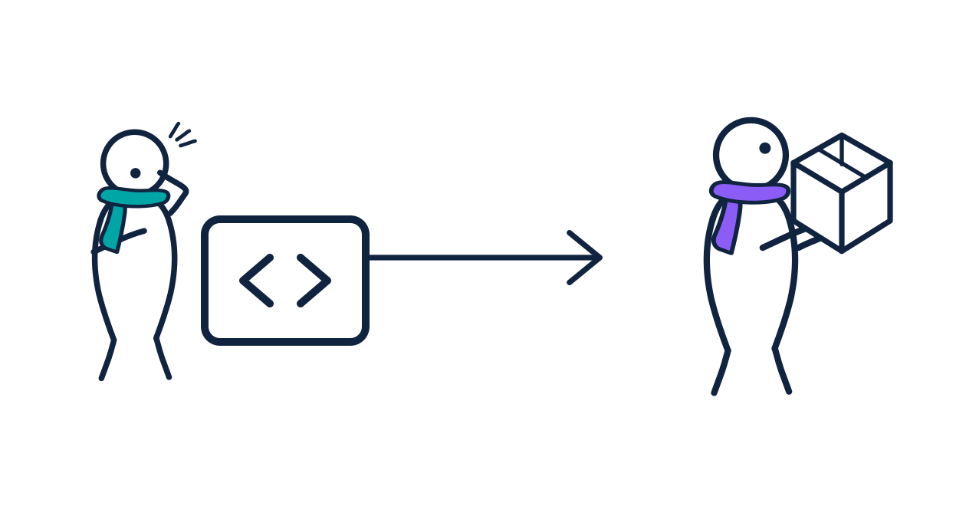
09
API product management in everyday work
Consumers and value: Who uses the API, and what does it help them do?
Ownership: Who is responsible for the product over its lifecycle?
Reuse and adoption: How can other teams discover and use the capability?
Lifecycle decisions: How should the product evolve as needs change?
Governance and developer experience: How do practices support product outcomes?
APIOps Cycles
Notes:
Source: Australian_Financial_Services_APIOps_Cycles_Case_Study (1).docx, supplied by the user. Client anonymised. Engagement by APIsFirst with partner Osaango. Benefits are qualitative; no quantified delivery or business impact is claimed.
Source section 3: Making API product management practical. The engagement helped teams understand product management responsibilities, reuse and adoption, ownership, lifecycle decisions and the link between governance, developer experience and product outcomes. These are related responsibilities, not five sequential implementation stages. No adoption metrics or proven deprecation outcomes are supplied.
Visual: APIOps Cycles design system, scene-api-first-not-enough.

Slide 10
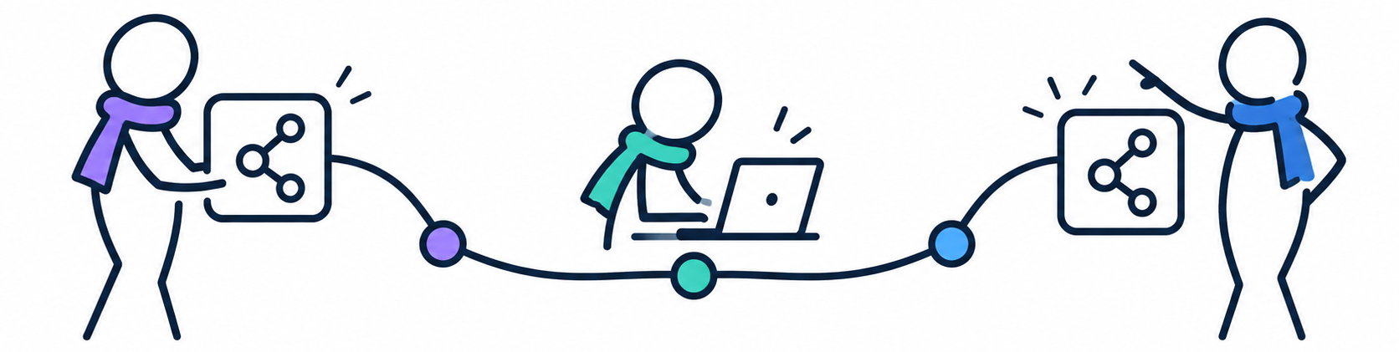
10
Portfolio planning coordinated API releases
Which APIs to create, improve or release, and in what sequence
API portfolio planning
Capability improvement
Priorities reflected partner integrations, UI development and dependencies between provider and consumer teams.
A complementary view addressed API discoverability, governance, developer experience and product management.
APIOps Cycles
Notes:
Source: Australian_Financial_Services_APIOps_Cycles_Case_Study (1).docx, supplied by the user. Client anonymised. Engagement by APIsFirst with partner Osaango. Benefits are qualitative; no quantified delivery or business impact is claimed.
Source section 4: Coordinating the API product portfolio. The roadmap prioritised API creation, improvement and release to support partner integrations and UI development. It made dependencies visible across provider, consumer and connected-service teams. A separate improvement view translated assessments and workshop findings into practical next steps. No release dates or actual dependency map are supplied.
Visual: AI-generated conceptual APIOps dependency illustration. It is not the client release roadmap.

Slide 11
11
The value across products, portfolio and ways of working
Connected work made decisions easier to discuss and repeat
Level | What the engagement connected | Qualitative value
API product | Consumer needs, business rules, contracts and technical controls | Shared understanding and more informed design
API portfolio | Provider and consumer dependencies with API priorities and releases | End-to-end visibility and coordinated delivery
Ways of working | Product ownership and lifecycle decisions with practical methods | Repeatable capability and continuous improvement
Qualitative benefits of the engagement. No quantified delivery or business impact is claimed.
APIOps Cycles
Notes:
Source: Australian_Financial_Services_APIOps_Cycles_Case_Study (1).docx, supplied by the user. Client anonymised. Engagement by APIsFirst with partner Osaango. Benefits are qualitative; no quantified delivery or business impact is claimed.
Source: The value of APIOps Cycles and Key takeaway. This editable summary compares the connected work and qualitative value at API product, API portfolio and organisational levels. No measured acceleration, revenue growth, savings or completed transformation is claimed.

