Slide 1

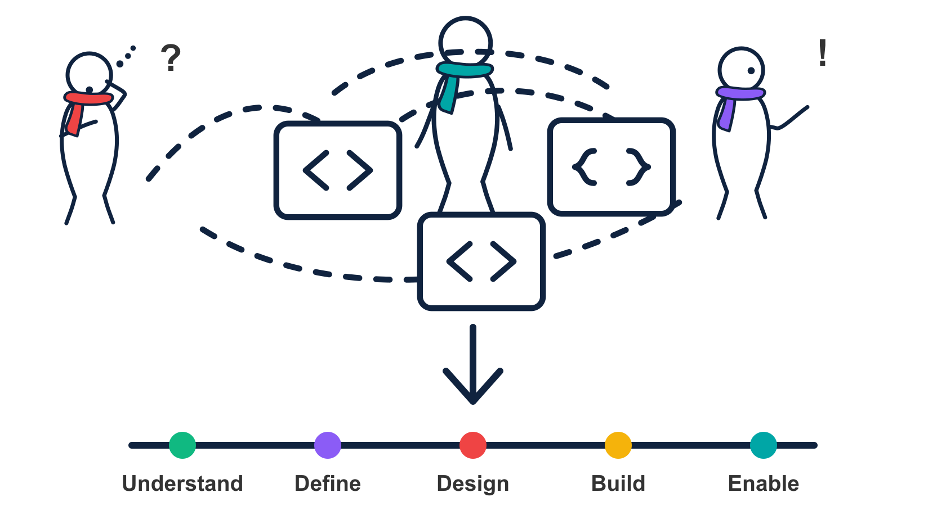
01
APIOps Cycles
Product strategy, architecture
and delivery with AI
An introduction grounded in a financial-services case
Case study: APIsFirst with partner Osaango
APIOps Cycles
Notes:
Source: Australian_Financial_Services_APIOps_Cycles_Case_Study (1).docx, supplied by the user. Client anonymised. Engagement by APIsFirst with partner Osaango. Benefits are qualitative; no quantified delivery or business impact is claimed.
The engagement applied APIOps Cycles to real API product development, coordinated release planning and organisational capability improvement. It connected business discovery with architecture, security, development and testing.
Visual: APIOps Cycles design system, scene-chaos-to-capabilities.

Slide 2
02
APIOps Cycles connects decisions across the lifecycle
An open method for connecting consumer value with architecture, design, delivery and continuous improvement.
Cycle view | Primary focus
Capability Productization | Define a reusable capability and the service promise.
API Productization | Develop, publish and improve an API as a product.
Integration Productization | Connect providers and consumers through reusable integrations.
Automation | Design and govern workflows, agents and operational controls.
This introduction follows API Productization, with a financial-services case and an illustrative payment continuation.
APIOps Cycles
Notes:
APIOps introduction. Technical continuation is illustrative; no client implementation or measured improvement is claimed.
The cycle catalog provides these four views over shared stations, resource guidance and readiness criteria. This deck follows the API Productization Cycle. Case-study statements derive from the supplied anonymised Word document. The supplier-payment canvases and subsequent technical decisions are illustrative.
Sources checked 3 November 2026:
src/data/method/cycles.json
src/lib/method-engine.js

Slide 3
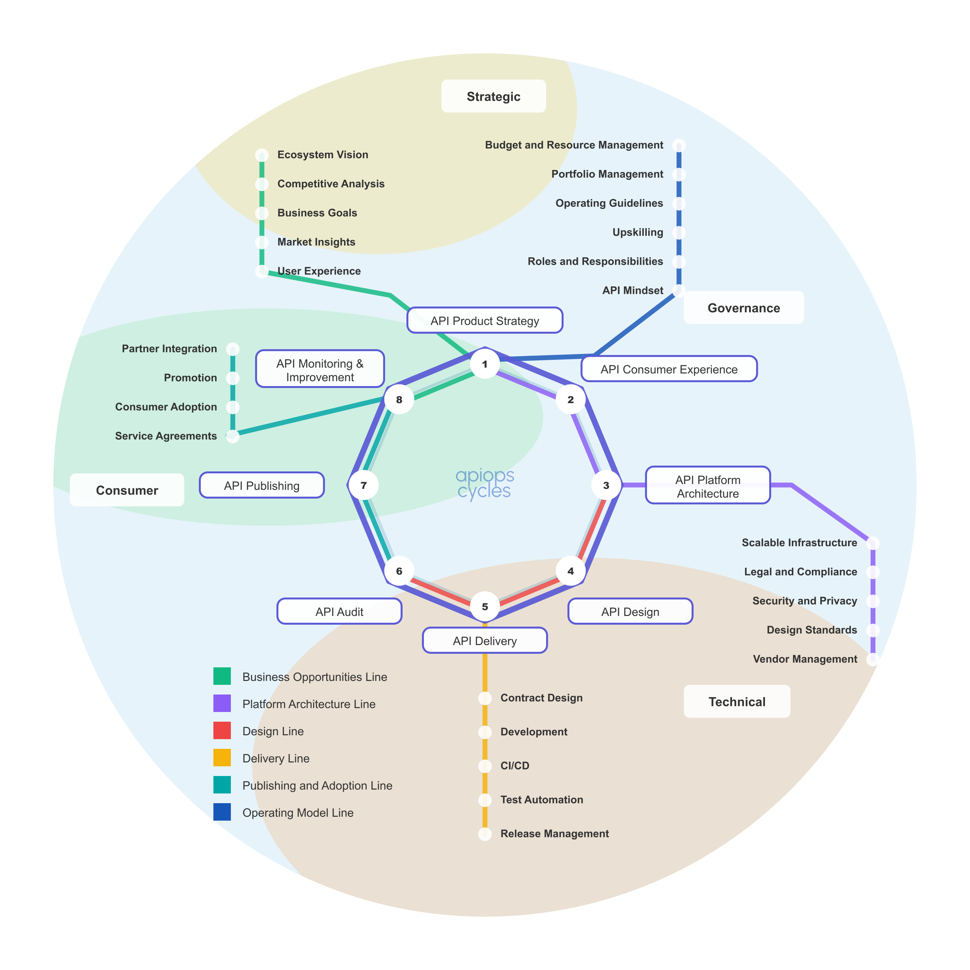
03
API Productization Cycle metro map
One lifecycle connects the work
API Product Strategy
API Consumer Experience
API Platform Architecture
API Design
API Delivery
API Audit
API Publishing
API Monitoring & Improvement
The engagement connected discovery to design, delivery and testing across these stations.
APIOps Cycles
Notes:
Source: Australian_Financial_Services_APIOps_Cycles_Case_Study (1).docx, supplied by the user. Client anonymised. Engagement by APIsFirst with partner Osaango. Benefits are qualitative; no quantified delivery or business impact is claimed.
Canonical API Productization Cycle map exported through the local repository application at /cycles/api-productization-cycle/ using Export SVG. Public reference: https://apiopscycles.com/cycles/api-productization-cycle/ . Supporting lines cover business opportunities, platform architecture, design, delivery, publishing and adoption, and operating model. The map is a method overview, not evidence that every station was completed during the engagement.

Slide 4
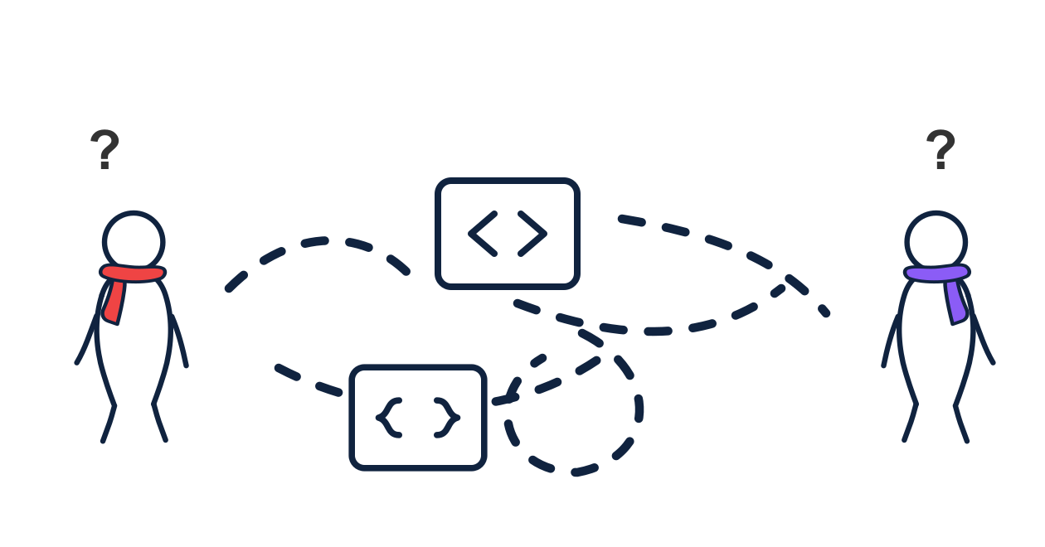
04
The challenge: dependencies across teams
Established API engineering practices
API products still depended on business and technology teams working across organisational boundaries.
Customer journeys and partner integrations had to fit internal services, legacy systems and compliance obligations.
Teams needed shared requirements, clearer ownership
and coordinated delivery decisions.
APIOps Cycles
Notes:
Source: Australian_Financial_Services_APIOps_Cycles_Case_Study (1).docx, supplied by the user. Client anonymised. Engagement by APIsFirst with partner Osaango. Benefits are qualitative; no quantified delivery or business impact is claimed.
The source describes an organisation with established API engineering practices. The challenge concerned shared business value, requirements, technical decisions, product management responsibilities and delivery coordination.
Visual: APIOps Cycles design system, scene-shared-picture-missing.

Slide 5
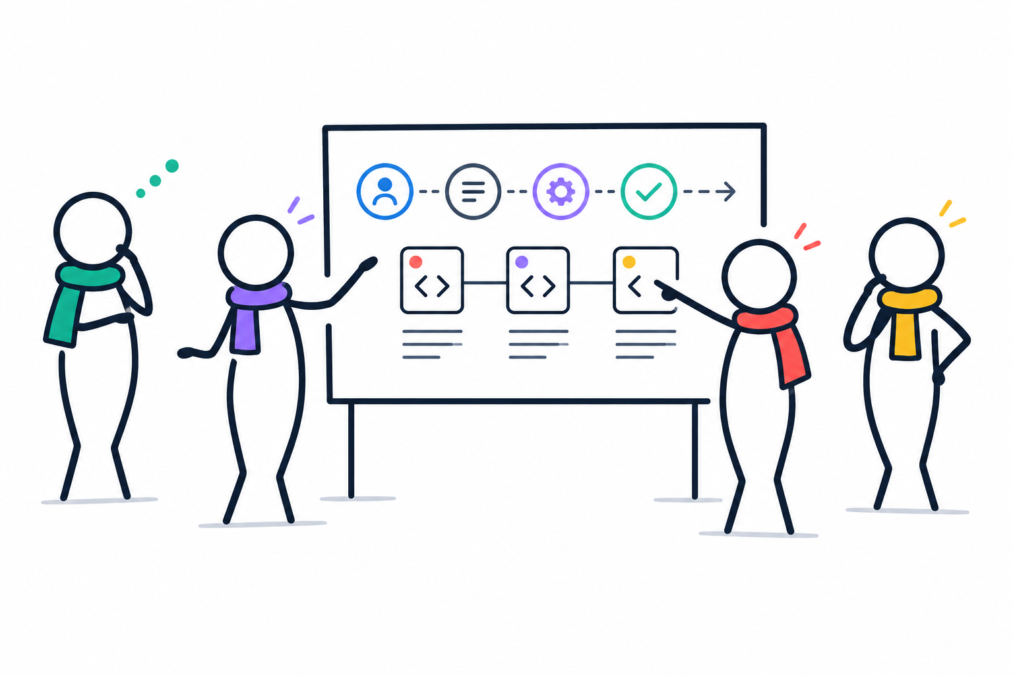
05
Collaborative discovery in the payments case
What the team did
APIsFirst and Osaango facilitated iterative workshops with business stakeholders, architects and engineers.
What the canvases made visible
Customer and API consumer journeys, value propositions, business rules and operating constraints.
Payments example: consumer details, payment method access, business risks and internal or partner channel needs.
APIOps Cycles
Notes:
Source: Australian_Financial_Services_APIOps_Cycles_Case_Study (1).docx, supplied by the user. Client anonymised. Engagement by APIsFirst with partner Osaango. Benefits are qualitative; no quantified delivery or business impact is claimed.
Source section 1: Collaborative product discovery and design. Teams also considered domain concepts, compliance, security, functional requirements and non-functional requirements. Canvases made assumptions visible before implementation choices. The source does not establish that every discrepancy was resolved.
Visual: AI-generated conceptual illustration using the APIOps scarf-human style. Not evidence of an actual workshop.

Slide 6
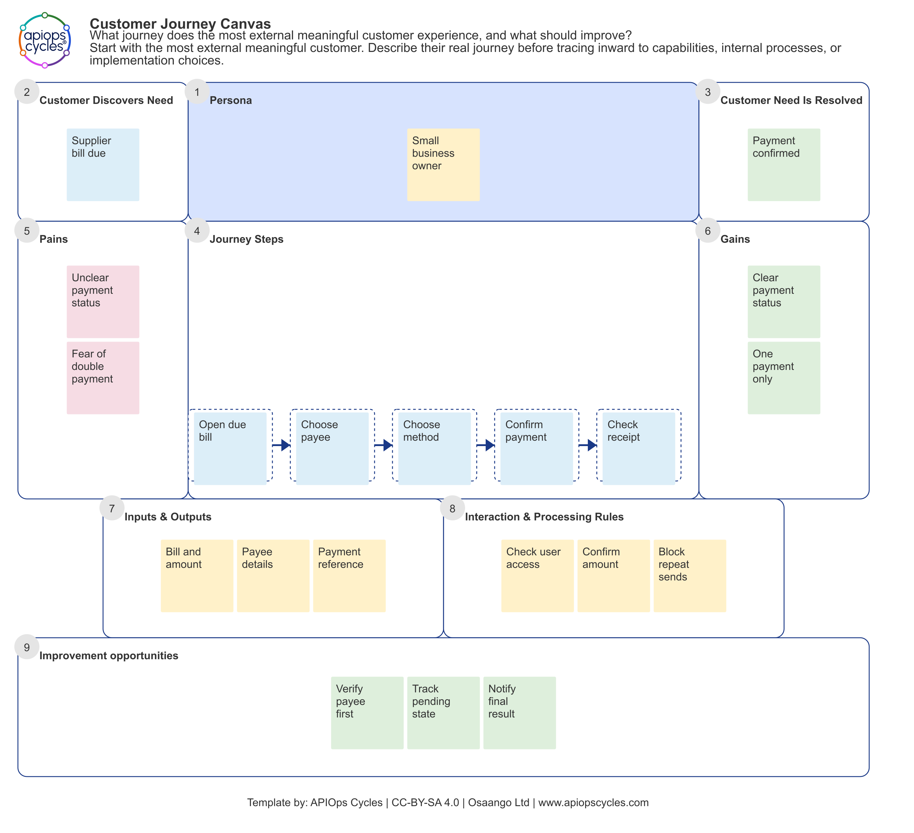
06
Customer Journey Canvas: a supplier payment
Customer and trigger
A small business owner has a supplier bill due and wants to know the payment has completed.
The customer journey
Open the due bill
Choose the payee
Choose a payment method
Confirm the payment
Check the receipt
Illustrative example. Not a client artefact.
APIOps Cycles
Notes:
Source: Australian_Financial_Services_APIOps_Cycles_Case_Study (1).docx, supplied by the user. Client anonymised. Engagement by APIsFirst with partner Osaango. Benefits are qualitative; no quantified delivery or business impact is claimed.
Newly authored fictional example for this case study: a small business owner pays a supplier invoice through a partner portal. The supplied real example set informed only the method of connecting customer tasks, pains, gains and API capabilities. No source screenshot, wording, institution, system identifier, endpoint, number or product name has been reused. Unclear status and duplicate-payment concern are illustrative hypotheses, not measured client findings. Template source: local apiops-cycles-method-data, customerJourneyCanvas. https://apiopscycles.com/resources/customer-journey-canvas/ . Template by APIOps Cycles and Osaango Ltd, CC-BY-SA 4.0. Importable example JSON: assets/illustrative_supplier_payment_customerJourneyCanvas_en.json.

Slide 7
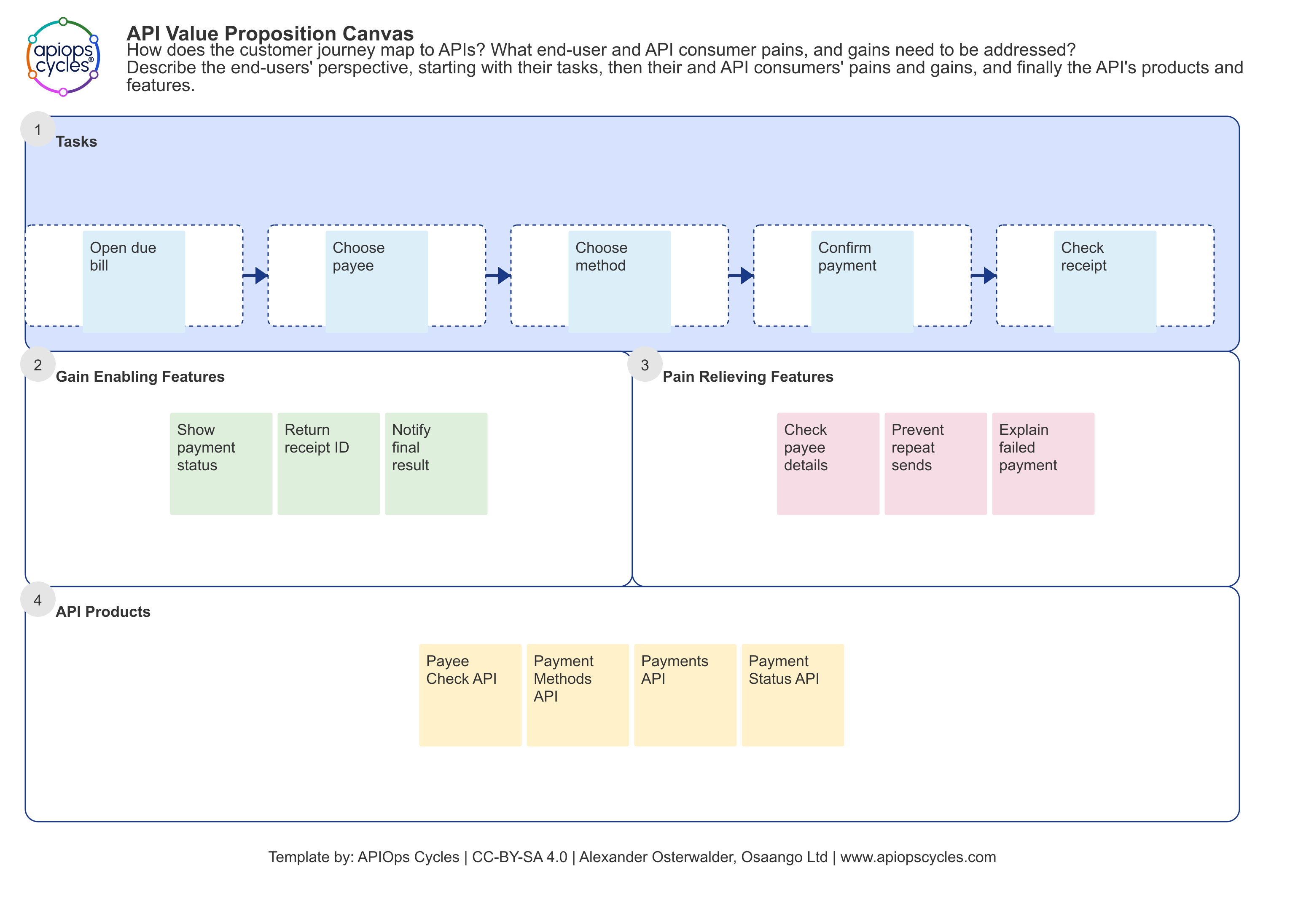
07
API Value Proposition Canvas: the same journey
Customer concern to API feature
Unclear payment status:
show progress and a receipt.
Repeat-payment concern:
prevent duplicate submissions.
Candidate API products
Payee Check API
Payment Methods API
Payments API
Payment Status API
Illustrative example. API names are provisional.
APIOps Cycles
Notes:
Source: Australian_Financial_Services_APIOps_Cycles_Case_Study (1).docx, supplied by the user. Client anonymised. Engagement by APIsFirst with partner Osaango. Benefits are qualitative; no quantified delivery or business impact is claimed.
The fictional example continues exactly the same five customer tasks as the preceding Customer Journey Canvas. Proposed gain-enabling features: status visibility, a receipt ID and notification of the final result. Proposed pain-relieving features: checking payee details, preventing repeat submissions and explaining failed payments. The four API product names are illustrative candidates, not actual client systems, delivered APIs or verified product boundaries. All canvas notes were authored afresh. No reference screenshots or client-specific details are embedded. Template source: local apiops-cycles-method-data, apiValuePropositionCanvas. https://apiopscycles.com/resources/api-value-proposition-canvas/ . Template by APIOps Cycles, Alexander Osterwalder and Osaango Ltd, CC-BY-SA 4.0. Importable example JSON: assets/illustrative_supplier_payment_apiValuePropositionCanvas_en.json.

Slide 8
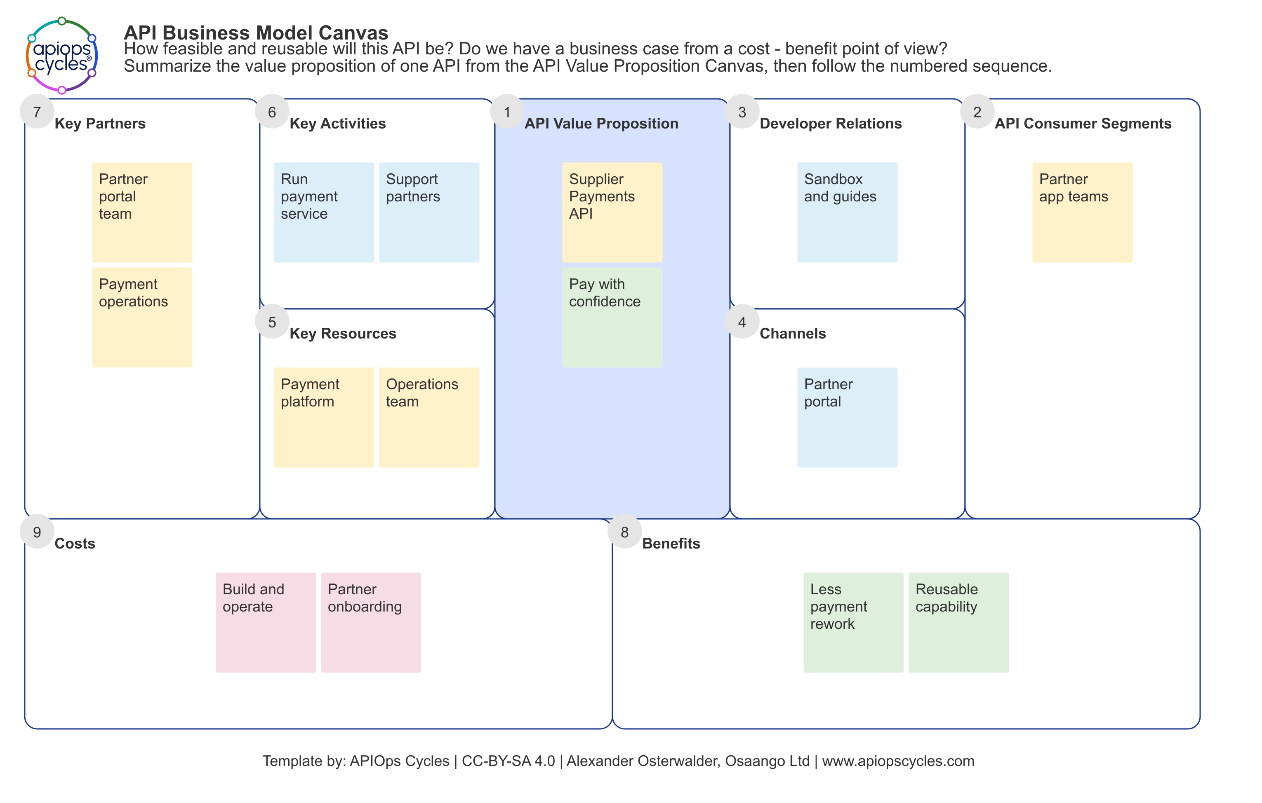
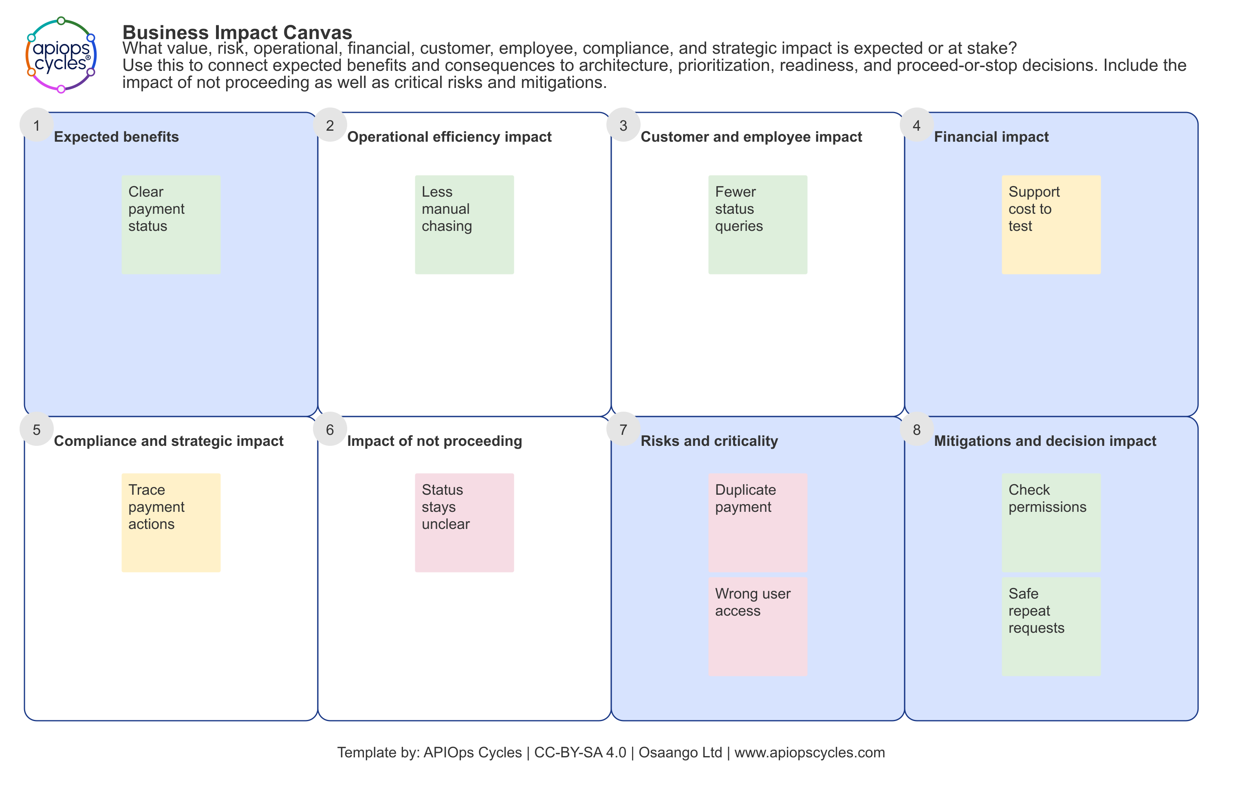
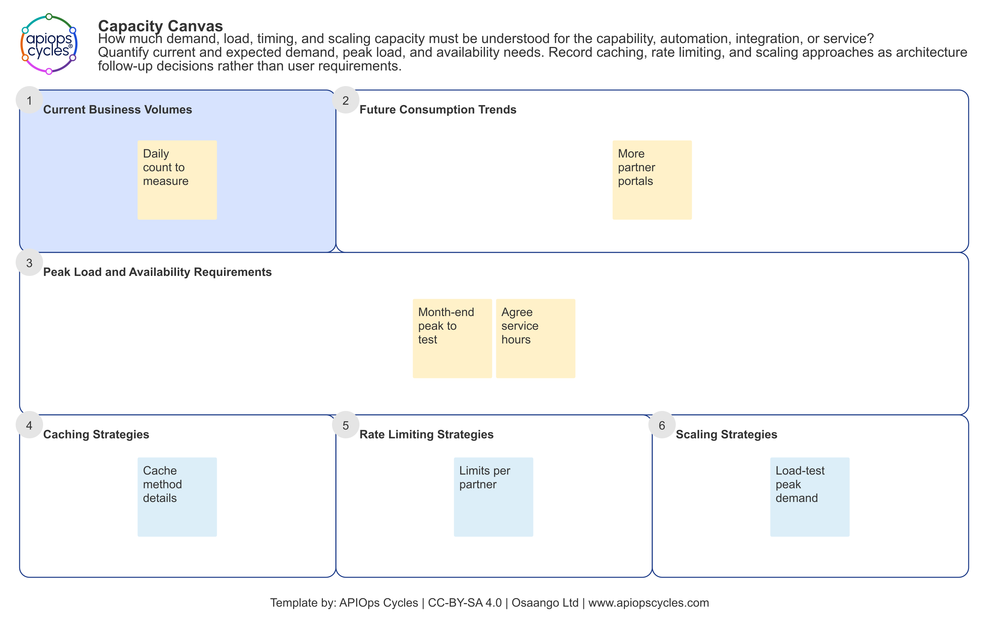
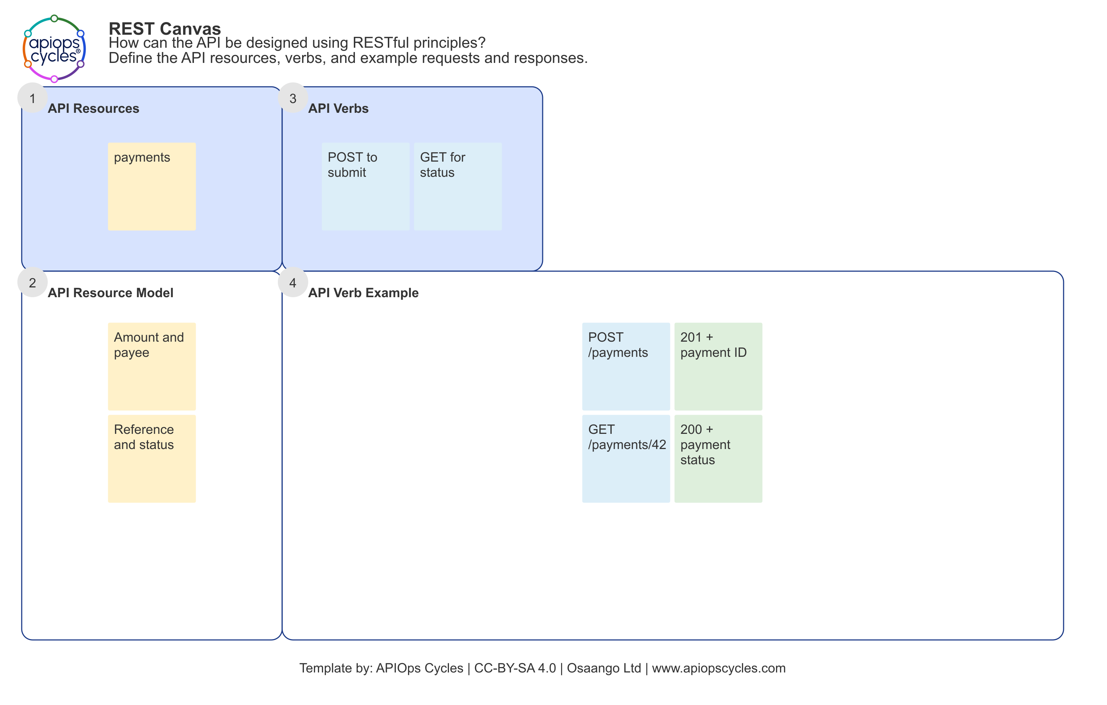
08
Other canvases supporting API product decisions
API Business Model Canvas
Business Impact Canvas
Value, partners and costs of the payments service
Expected benefits, consequences and critical risks
Capacity Canvas
REST API Canvas
Demand baseline, peak load and scaling decisions
Payment resources, verbs and response examples
Illustrative supplier-payment examples. Capacity measurements and assumptions require validation.
APIOps Cycles
Notes:
Source: Australian_Financial_Services_APIOps_Cycles_Case_Study (1).docx, supplied by the user. Client anonymised. Engagement by APIsFirst with partner Osaango. Benefits are qualitative; no quantified delivery or business impact is claimed.
Four newly authored illustrative examples continue the fictional supplier-payment scenario. They demonstrate the canonical API Business Model, Business Impact, Capacity and REST canvases. They do not reproduce the supplied real reference set, and are not evidence of actual client artefacts or delivered capabilities. The business-model canvas names the provisional Supplier Payments API before its value proposition. Impact entries describe expected benefits and risks, not observed impact. Capacity entries explicitly identify a volume baseline to measure, a peak to test and service hours to agree; no traffic forecast or measured capacity is invented. REST request and response examples are illustrative only. Canonical templates: local apiops-cycles-method-data canvasData.json and localizedData.json, IDs apiBusinessModelCanvas, businessImpactCanvas, capacityCanvas, restCanvas. Template attribution: APIOps Cycles and Osaango Ltd, with Alexander Osterwalder for API Business Model Canvas. CC-BY-SA 4.0. Importable illustrative JSON and full-size canvas images are saved under assets.

Slide 9
09
Discovery informed decisions across the lifecycle
Payment API design connected consumer needs to technical controls
Consumer tasks | Requirements | API design | Controls | Testing
Journeys and channel needs | Business rules and constraints | Domain model and contracts | Access, limits and monitoring | API test automation
Practical support
AI modernisation guidance
Guidance on API contracts and test automation. Cross-team input on unresolved architecture and security decisions.
Advice on using AI to convert legacy interfaces while retaining business requirements and constraints.
APIOps Cycles
Notes:
Source: Australian_Financial_Services_APIOps_Cycles_Case_Study (1).docx, supplied by the user. Client anonymised. Engagement by APIsFirst with partner Osaango. Benefits are qualitative; no quantified delivery or business impact is claimed.
Source section 2: Following the product through the lifecycle. The table is a conceptual summary of the traceability described, not a reproduced project artefact. Design material also addressed operations, authentication and authorisation, rate limits, error handling, monitoring, asynchronous processing and capacity planning. The engagement included advice on AI-assisted conversion. It does not establish completed conversion, acceleration, uninterrupted operations or measured test improvements.

Slide 10
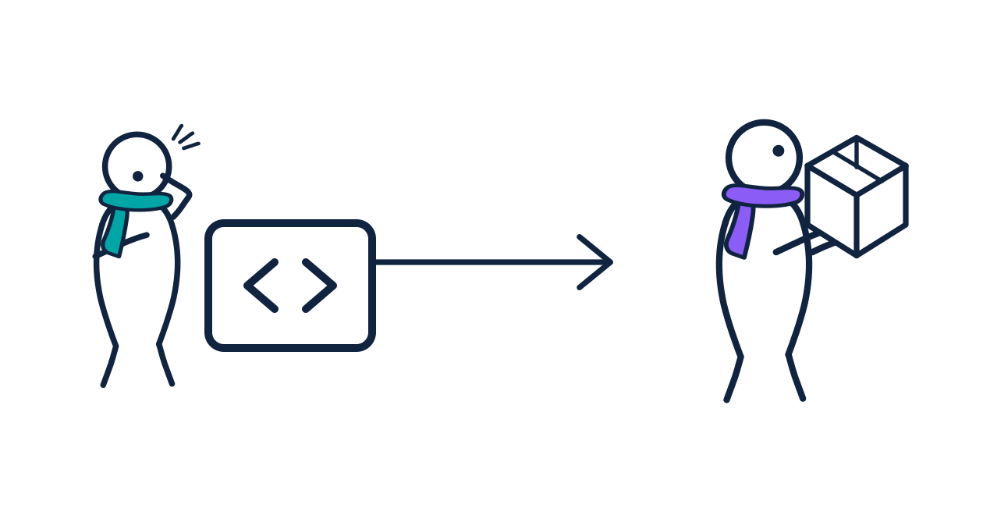
10
API product management in everyday work
Consumers and value: Who uses the API, and what does it help them do?
Ownership: Who is responsible for the product over its lifecycle?
Reuse and adoption: How can other teams discover and use the capability?
Lifecycle decisions: How should the product evolve as needs change?
Governance and developer experience: How do practices support product outcomes?
APIOps Cycles
Notes:
Source: Australian_Financial_Services_APIOps_Cycles_Case_Study (1).docx, supplied by the user. Client anonymised. Engagement by APIsFirst with partner Osaango. Benefits are qualitative; no quantified delivery or business impact is claimed.
Source section 3: Making API product management practical. The engagement helped teams understand product management responsibilities, reuse and adoption, ownership, lifecycle decisions and the link between governance, developer experience and product outcomes. These are related responsibilities, not five sequential implementation stages. No adoption metrics or proven deprecation outcomes are supplied.
Visual: APIOps Cycles design system, scene-api-first-not-enough.

Slide 11
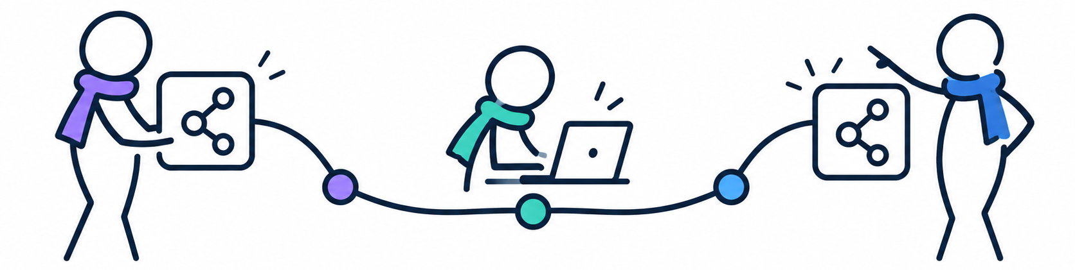
11
Portfolio planning coordinated API releases
Which APIs to create, improve or release, and in what sequence
API portfolio planning
Capability improvement
Priorities reflected partner integrations, UI development and dependencies between provider and consumer teams.
A complementary view addressed API discoverability, governance, developer experience and product management.
APIOps Cycles
Notes:
Source: Australian_Financial_Services_APIOps_Cycles_Case_Study (1).docx, supplied by the user. Client anonymised. Engagement by APIsFirst with partner Osaango. Benefits are qualitative; no quantified delivery or business impact is claimed.
Source section 4: Coordinating the API product portfolio. The roadmap prioritised API creation, improvement and release to support partner integrations and UI development. It made dependencies visible across provider, consumer and connected-service teams. A separate improvement view translated assessments and workshop findings into practical next steps. No release dates or actual dependency map are supplied.
Visual: AI-generated conceptual APIOps dependency illustration. It is not the client release roadmap.

Slide 12
12
The value across products, portfolio and ways of working
Connected work made decisions easier to discuss and repeat
Level | What the engagement connected | Qualitative value
API product | Consumer needs, business rules, contracts and technical controls | Shared understanding and more informed design
API portfolio | Provider and consumer dependencies with API priorities and releases | End-to-end visibility and coordinated delivery
Ways of working | Product ownership and lifecycle decisions with practical methods | Repeatable capability and continuous improvement
Qualitative benefits of the engagement. No quantified delivery or business impact is claimed.
APIOps Cycles
Notes:
Source: Australian_Financial_Services_APIOps_Cycles_Case_Study (1).docx, supplied by the user. Client anonymised. Engagement by APIsFirst with partner Osaango. Benefits are qualitative; no quantified delivery or business impact is claimed.
Source: The value of APIOps Cycles and Key takeaway. This editable summary compares the connected work and qualitative value at API product, API portfolio and organisational levels. No measured acceleration, revenue growth, savings or completed transformation is claimed.

Slide 13
13
Architecture: business needs become operating decisions
Method input | Decision it supports | Review with
Business Impact Canvas | Failure consequences, resilience and acceptable degradation | Product owner, security and operations
Locations Canvas | Trust boundaries, connectivity and data-location constraints | Architecture, security and compliance
Capacity Canvas | Demand, peaks, availability and scaling assumptions | Business and platform owners
Metrics and analytics | Observable service behaviour and consumer outcomes | Operations and API product owner
The next station needs architecture choices that stakeholders have reviewed.
APIOps Cycles
Notes:
APIOps introduction. Technical continuation is illustrative; no client implementation or measured improvement is claimed.
Canonical API Platform Architecture resources and the API Design entry criteria require validated architecture and shared conventions. Canvas contents inform decisions; they do not prescribe a vendor or deployment topology.
Sources checked 3 November 2026:
method-engine: buildStationResourceData(api-platform-architecture), buildStartData(en, api-productization-cycle)

Slide 14
14
A payment requirement can change the architecture
Customer or business need | Proposed design decision | Evidence to review
One payment per instruction | Define replay handling and a durable deduplication record | Repeated request and concurrent-submission tests
Clear progress and final outcome | Separate resource creation from completion of the business payment | State-transition and consumer walkthrough tests
A partner sees only its payments | Enforce access for the requested object and the caller context | Cross-partner denial tests
Dependable month-end service | Measure peak demand and agree capacity and recovery behaviour | Load tests and failure recovery evidence
Illustrative choices to validate, rather than facts about the client implementation.
APIOps Cycles
Notes:
APIOps introduction. Technical continuation is illustrative; no client implementation or measured improvement is claimed.
Proposed architecture decisions for the fictional supplier-payment continuation. Idempotency scope, retention, conflict handling and recovery remain decisions to validate. A successful HTTP creation response does not establish completion of the underlying payment. Object-level access control requires implementation and tests.
Sources checked 3 November 2026:
src/snippets/api-design-principles-guidance.md
https://api-security.owasp.org/editions/2023/en/0xa1-broken-object-level-authorization/

Slide 15
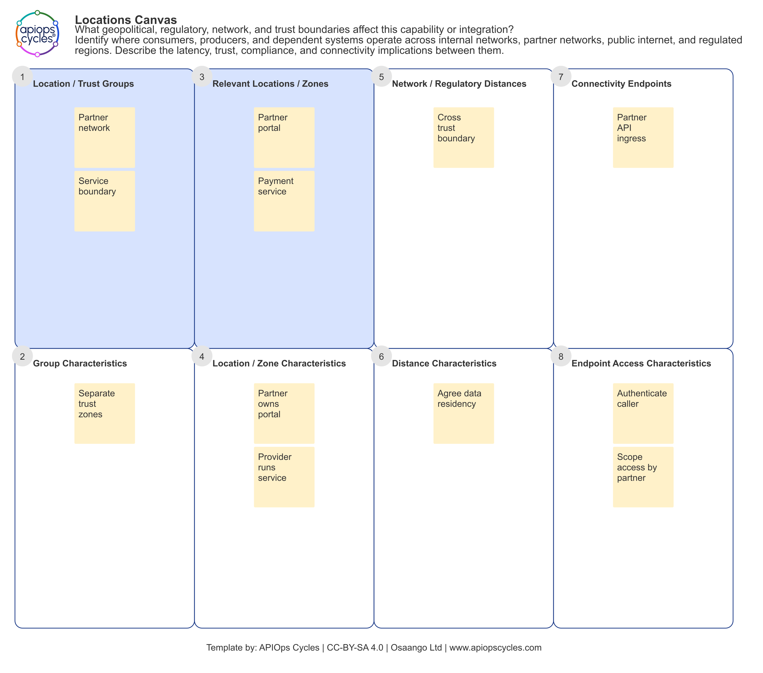
15
Trust boundaries and capacity need explicit answers
Trust and access
Identify the caller and permitted payment objects.
Agree exposed endpoints, network paths and data locations.
Demand and resilience
Measure normal and peak demand before setting limits.
Test retries, delays and recovery without duplicate processing.
APIOps Cycles
Notes:
APIOps introduction. Technical continuation is illustrative; no client implementation or measured improvement is claimed.
The Locations Canvas and questions are canonical method resources. The filled diagram is newly authored and fictional. No actual client topology, residency decision, traffic volume, capacity target or production control is disclosed or claimed.
Sources checked 3 November 2026:
method-engine: buildCanvasMetadata(locationsCanvas, en)
method-engine: buildCanvasMetadata(capacityCanvas, en)

Slide 16
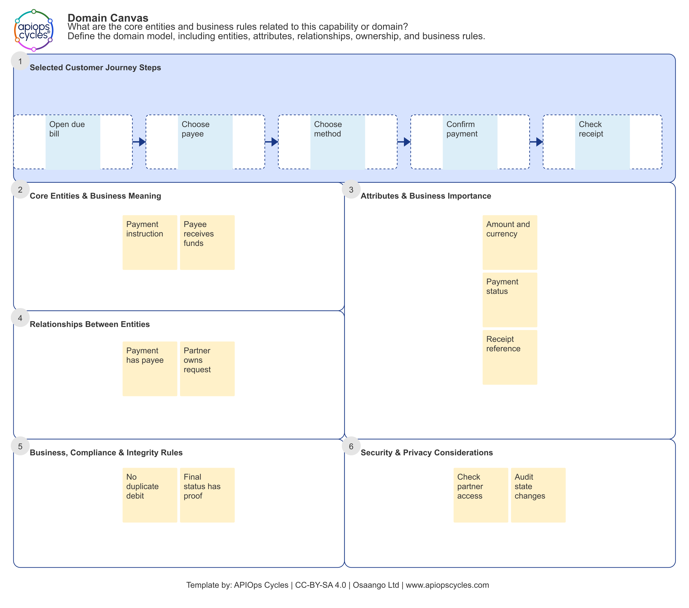
16
API design starts with shared domain meaning
Payment and payee
A payment is an instruction with an amount, currency, payee and a lifecycle status.
Business rules shape the contract
Keep accepted, pending and completed meanings distinct.
Agree ownership and the source of truth for state changes.
APIOps Cycles
Notes:
APIOps introduction. Technical continuation is illustrative; no client implementation or measured improvement is claimed.
API Design links Domain Canvas, Interaction Canvas, protocol-specific canvases, design principles and contract-first design. The domain entries are illustrative working definitions. Validate business meanings and state transitions before adopting them. The prior Customer Journey Canvas supplies the actor, trigger and sequence for this example.
Sources checked 3 November 2026:
method-engine: buildStationResourceData(api-design, en, REST)
src/snippets/api-style-guide.json: REST-DOMAIN-01, REST-DOMAIN-02

Slide 17
17
Interaction design precedes the interface contract
Consumer task | Candidate interaction | Contract questions
Submit a payment instruction | REST request creating a payment resource | Required data, replay behaviour, creation response and errors
Check the outcome | REST query returning the current payment state | Status meaning, freshness and permitted access
Receive a final update | Event or callback if consumer needs justify it | Delivery, retry, ordering and duplicate handling
Compose a portal view | GraphQL only where its query model serves the need | Schema, authorisation and query-cost controls
The Interaction Canvas explores the flow; REST, Event or GraphQL canvases refine the chosen style.
APIOps Cycles
Notes:
APIOps introduction. Technical continuation is illustrative; no client implementation or measured improvement is claimed.
Canonical design resource mapping includes domain and interaction modelling, style-specific canvases and contract-first guidance. These interactions are options for a fictional example, not a mandate to implement every style. The final choice depends on consumer tasks and reviewed architecture.
Sources checked 3 November 2026:
method-engine: buildStationResourceData(api-design, en, REST)
src/data/canvas/canvasData.json: interactionCanvas, restCanvas, eventCanvas, graphqlCanvas

Slide 18
18
Contract-first design makes behaviour reviewable
POST /payments
Idempotency-Key: <request-key>
201 Created
{
"paymentId": "pay-42",
"status": "pending"
}
Decisions around this operation
Define amount, currency, payee and validation errors.
Specify replay scope, retention and conflicting-payload behaviour.
Declare authentication and required permissions.
Keep resource creation distinct from payment completion.
Illustrative contract excerpt. The idempotency policy still needs agreement and implementation.
APIOps Cycles
Notes:
APIOps introduction. Technical continuation is illustrative; no client implementation or measured improvement is claimed.
Illustrative operation and payload, not copied from a client contract or supplied by the scaffold. The starter scaffold contract uses OpenAPI 3.0.3 and a read-only Catalog example. OpenAPI describes operations, schemas, responses and security requirements; the service enforces the agreed behaviour. The proposed Idempotency-Key header represents an application contract decision.
Sources checked 3 November 2026:
src/snippets/api-contract-example.yaml
src/snippets/api-style-guide.json: REST-CONTRACT-01, REST-CONTRACT-02, REST-VALIDATION-01
https://spec.openapis.org/oas/v3.0.3

Slide 19
19
The scaffold gives people and AI a shared workspace
Project location | Purpose
specs/canvases/ | Editable method decisions
specs/openapi/api.yaml | Project-owned API contract
docs/api/ | Review and generated outputs
spectral/ and scripts/ | Lint rules and audit checks
.github/workflows/ | Automated review workflow
npm create apiops@latest payments
cd payments
npm run method:start
npm run method:canvases:new-api
Choose API Productization and REST in the prompts. The tooling requires Node.js 22 or later.
The starter includes a sample Catalog contract; your team builds the payment runtime in its chosen language.
APIOps Cycles
Notes:
APIOps introduction. Technical continuation is illustrative; no client implementation or measured improvement is claimed.
Source-reviewed local versions: apiops-cycles-method-data 4.2.1 and create-apiops 1.1.4. The npm initializer command is documented by the local package. An isolated project was generated with the local initializer, API Productization, REST, English and --no-install. That mode skips installation and canvas generation. The command block shows the normal installed workflow. The scaffold supplies a design and review workspace, not a complete payment implementation.
Sources checked 3 November 2026:
packages/create-apiops/README.md
packages/create-apiops/template/README.md
packages/create-apiops/template/package.json
Local scaffold verification: .codex-artifacts/apiops-intro/scaffold-check/intro-payments-demo

Slide 20
20
AI needs the decisions behind the contract
Input supplied to AI | What it constrains | Human owner
Journey and value proposition | Supported task, intended value and consumer expectations | Product and consumer representatives
Domain and architecture outputs | Meaning, ownership, trust and operational constraints | Domain, architecture and security owners
Validated contract and style guide | Interface behaviour, validation and shared conventions | API designer
Audit findings and test evidence | Known gaps, acceptance criteria and the next bounded change | Engineering and readiness owners
AGENTS.md and package skills provide a route through the method; the team still validates the decisions.
APIOps Cycles
Notes:
APIOps introduction. Technical continuation is illustrative; no client implementation or measured improvement is claimed.
Recommended AI working pattern derived from the scaffold AGENTS.md and method guidance. The new-api-guide skill prefers the shared method engine and station readiness criteria. Canvas JSON authoring and export skills support reviewable decisions. The presence of a starter OpenAPI file does not establish design readiness. This is guidance for AI-assisted work, not a claim that the initializer automates implementation.
Sources checked 3 November 2026:
packages/create-apiops/template/AGENTS.md
skills/new-api-guide/SKILL.md
src/snippets/api-design-principles-guidance.md

Slide 21
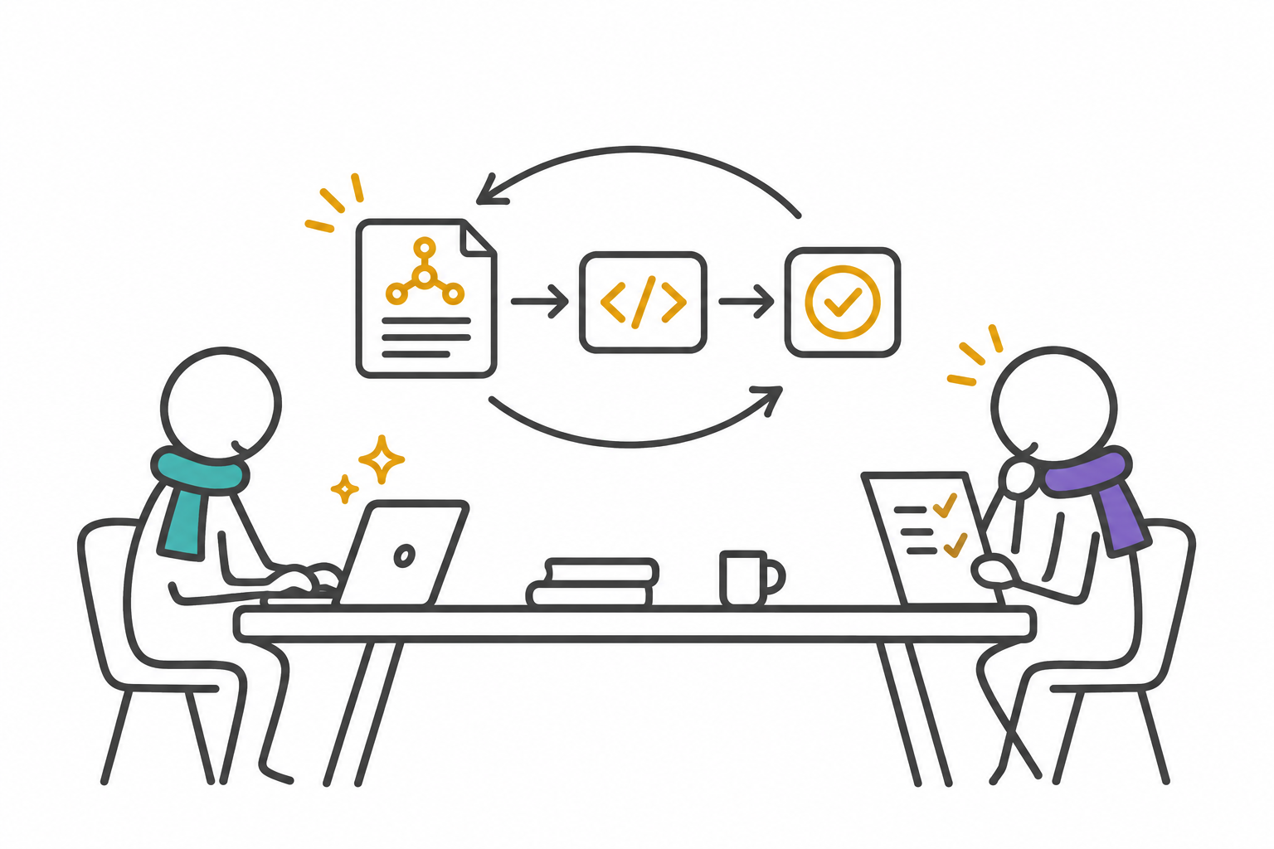
21
Building with AI works best as a bounded change
Select one reviewed operation and its acceptance criteria.
Ask for an implementation diff and tests against the contract.
Run checks, inspect behaviour and record unresolved decisions.
Have the responsible people review the evidence before merging.
Suggested task: implement payment submission with replay and cross-partner denial tests.
APIOps Cycles
Notes:
APIOps introduction. Technical continuation is illustrative; no client implementation or measured improvement is claimed.
Recommended iterative working pattern. The validated contract, domain rules, architecture decisions and critical journeys constrain the implementation. The example task is illustrative. AI output requires review and execution of meaningful tests. Source guidance explicitly connects delivery with prior method outputs. Visual generated with the built-in image generation tool using the APIOps scarf-human style; conceptual, not a client workshop photograph.
Sources checked 3 November 2026:
src/snippets/api-design-principles-guidance.md
packages/create-apiops/template/AGENTS.md

Slide 22
22
Tests turn the payment promises into evidence
Promise or risk | Example test | What to inspect
Contract consistency | Validate valid and invalid requests and responses | Schemas, error bodies and documented status codes
Replay protection | Repeat a request and submit concurrent duplicates | Stable result and no duplicate processing
Partner isolation | Read or alter a payment owned by another partner | Denied access and appropriate audit evidence
Clear failure behaviour | Simulate a slow or unavailable dependency | Agreed timeout, recovery and consumer-visible status
Peak demand | Exercise a measured peak traffic model | Latency, errors and resource consumption
These tests extend the scaffold with runtime evidence for the chosen implementation.
APIOps Cycles
Notes:
APIOps introduction. Technical continuation is illustrative; no client implementation or measured improvement is claimed.
Illustrative acceptance-test ideas derived from journey, architecture and contract decisions. No test execution or client performance result is claimed. The repository guidance includes functional, security and performance testing. Object-level access tests support the OWASP recommendation to validate permissions for requested objects. The scaffold does not supply this payment runtime or these application tests.
Sources checked 3 November 2026:
method-engine: buildResourceMetadata(api-testing-best-practices, en)
src/snippets/api-design-principles-guidance.md
https://api-security.owasp.org/editions/2023/en/0xa1-broken-object-level-authorization/

Slide 23
23
Linting checks the contract against explicit rules
npm run lint:openapi:full-crud
Scaffold profile | Rules in the inspected template | Use in this example
read-only | spectral:oas, a versioned server path and bans on write methods | For a genuinely read-only API
full-crud | The shared base rules, without the read-only verb bans | For the payment API with POST
The full-crud name permits writes; it does not require every CRUD operation.
The scaffold validate:openapi command runs both profiles, so a write-enabled API needs a deliberate profile choice.
APIOps Cycles
Notes:
APIOps introduction. Technical continuation is illustrative; no client implementation or measured improvement is claimed.
Verified against the actual Spectral YAML and npm scripts. read-only extends base.yaml and prohibits POST, PUT, PATCH and DELETE. full-crud extends the same base and adds no rules. base.yaml extends spectral:oas and checks server URLs against ^/v\d+$, for example /v1. The README wording calling full-crud stricter is not used here because the implementation is authoritative. These are configured rules, not proof of the full style guide or runtime security. No Spectral execution result is claimed.
Sources checked 3 November 2026:
packages/create-apiops/template/spectral/base.yaml
packages/create-apiops/template/spectral/read-only.yaml
packages/create-apiops/template/spectral/full-crud.yaml
packages/create-apiops/template/package.json
https://github.com/stoplightio/spectral

Slide 24
24
API Audit brings evidence together across the lifecycle
npm run audit:design:full-crud
Coverage area | Evidence to review
Strategy and architecture | Consumer value, architecture decisions, trust boundaries and capacity
Design | Contract checks, examples, conventions and consumer review
Delivery | Functional, security, resilience and performance tests
Publishing | Documentation, access, support and readiness decisions
Improving | Runtime metrics, adoption and feedback connected to the next change
The report uses pass, partial, gap and not applicable. Manual items require evidence and owner review.
APIOps Cycles
Notes:
APIOps introduction. Technical continuation is illustrative; no client implementation or measured improvement is claimed.
The package audit checklist uses six lifecycle stages: Strategy, Architecture, Design, Delivery, Publishing and Improving. In the inspected default checklist, Improving currently has no checklist items, so teams must add meaningful improvement evidence. The eight core stations remain the navigation model. The audit script reads the canonical package checklist unless a project-local override exists, combines spec checks and manual/default statuses, and emits JSON, Markdown, HTML and JUnit. The table describes evidence expectations; it is not an actual result for this example.
Sources checked 3 November 2026:
src/snippets/api-audit-checklist.json
packages/create-apiops/template/scripts/run-design-audit.js
packages/create-apiops/template/specs/audit/README.md

Slide 25
25
A check result needs a clear interpretation
Starter check or signal | What the inspected code checks | Evidence to add
Examples pass validation | Presence of an example somewhere in the specification | Actual example-to-schema validation
Validation workflow present | Existence of the expected workflow file | Successful execution and meaningful test results
Opaque identifier check | Names specific to the starter Catalog example | Checks adapted to payment identifiers and contracts
Manual readiness item | The checklist default status, commonly partial | Review of the actual evidence by the accountable owner
Adapt the starter checks to the API domain before treating coverage as a release decision.
APIOps Cycles
Notes:
APIOps introduction. Technical continuation is illustrative; no client implementation or measured improvement is claimed.
Direct implementation review: checkExamplesPassValidation returns hasAnyExample(spec); checkValidationWorkflowPresent checks file existence; checkOpaqueIdentifiers looks for productId, variantId and categoryId; normalizeStatus returns manual defaultStatus or partial. These limitations are concrete in the inspected local create-apiops 1.1.4 template. The canonical JSON style guide is guidance and linked audit metadata; it is not automatically compiled into a complete Spectral ruleset. Review and extend automation rather than interpreting report generation as verified readiness.
Sources checked 3 November 2026:
packages/create-apiops/template/scripts/run-design-audit.js: checkExamplesPassValidation, checkValidationWorkflowPresent, checkOpaqueIdentifiers, normalizeStatus
src/snippets/api-style-guide.json

Slide 26
26
CI can keep the review evidence current
Included scaffold workflow
Extend for the payment implementation
Install dependencies with npm ci.
Lint the selected profile and generate audit reports.
Publish the JUnit coverage result as a GitHub check.
Run contract, integration, security and load tests.
Define which lint findings, gaps and failed tests block release.
Review changes to contracts, controls and generated evidence together.
Audit outputs: JSON for tooling, Markdown and HTML for review, JUnit for CI.
APIOps Cycles
Notes:
APIOps introduction. Technical continuation is illustrative; no client implementation or measured improvement is claimed.
The inspected .github/workflows/openapi-lint.yml installs with npm ci, lints, generates audit reports and publishes JUnit. It defaults to read-only and supports manual full-crud selection. The audit runner writes reports; its CLI does not itself fail merely because coverage includes gaps. The JUnit publisher step has continue-on-error enabled. Teams should define explicit gating behaviour for the chosen profile and runtime tests. No changes were made to production CI.
Sources checked 3 November 2026:
packages/create-apiops/template/.github/workflows/openapi-lint.yml
packages/create-apiops/template/scripts/run-design-audit.js
packages/create-apiops/template/README.md

Slide 27
27
Publishing and improvement complete the product cycle
API Publishing
API Monitoring & Improvement
Publish the reviewed contract and consumer-facing examples.
Make access, onboarding and support ownership clear.
Keep service terms and operational responsibilities visible.
Observe payment completion, pending age, latency and errors.
Combine runtime evidence with adoption and consumer feedback.
Revisit architecture, contracts and priorities when assumptions change.
The next improvement starts with evidence from consumers and operations.
APIOps Cycles
Notes:
APIOps introduction. Technical continuation is illustrative; no client implementation or measured improvement is claimed.
Canonical API Publishing resources cover release channels, documentation, onboarding and readiness. Monitoring and Improving resources cover performance, adoption, feedback and continuous improvement. Payment completion and pending age are proposed example metrics, not measured client results or package defaults.
Sources checked 3 November 2026:
method-engine: buildStationResourceData(api-publishing, en, REST)
method-engine: buildStationResourceData(monitoring-and-improving, en, REST)

Slide 28
28
A first working cycle
Agree one API product, a consumer journey and an accountable owner.
Record the architecture choices and review one contract.
Build one path with AI assistance and meaningful tests.
Lint, audit and share findings before the next release decision.
Method and project resources
apiopscycles.com
apiops-cycles-method-data
create-apiops
CanvasCreator
Local reference versions checked: method-data 4.2.1 and create-apiops 1.1.4. 3 November 2026.
APIOps Cycles
Notes:
APIOps introduction. Technical continuation is illustrative; no client implementation or measured improvement is claimed.
Suggested introduction-to-practice sequence. Sources reviewed include the supplied anonymised Word case study, the previously prepared strategy case deck, installed apiops-cycles-method-data 4.2.1, create-apiops 1.1.4 template and initializer, and the matching local method-data repository. Technical examples and AI workflow recommendations are newly authored illustrative continuations. The case benefits remain qualitative. The local scaffold was generated with --no-install, so no live payment service, Spectral run or runtime test outcome is claimed.
Sources checked 3 November 2026:
https://apiopscycles.com/
https://github.com/APIOpsCycles/apiops-cycles-method-data
packages/create-apiops/README.md
src/lib/method-engine.js

